Slide 1

Optimal Illiquidity in the
Retirement Savings System
John Beshears
James J. Choi
Christopher Clayton
Christopher Harris
David Laibson
Brigitte C. Madrian
August 8, 2014

Slide 2
Many savings vehicles with varying degrees of liquidity
Social Security
Home equity
Defined benefit pensions
Annuities
Defined contribution accounts
IRA’s
CD’s
Brokerage accounts
Checking/savings

Slide 3

Retirement Plan Leakage
Source: GAO-09-715, 2009

Slide 4
“Leakage” (excluding loans) among households ≤ 55 years old
For every $1 that flows into US retirement savings system $0.40 leaks out
(Argento, Bryant, and Sabelhaus 2014)

Slide 5


What is the societally optimal level of household liquidity?

Slide 6
US Anti-Leakage Strategy
Defined Contribution Pension Schemes
(e.g., 401(k) and IRA)
10% penalty for early withdrawals
Allow in-service loans without penalty
  10% penalty if not repaid
Special categories of penalty-free withdrawals
  Education
  Large health expenditures
  First home purchase
Unintended liquidity: IRA tax arbitrage

Slide 7
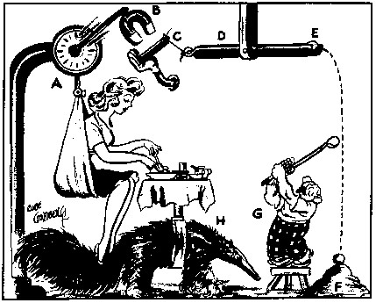
Societally optimal savings:
Behavioral mechanism design

Slide 8
Behavioral mechanism design
Specify a theory of consumer behavior
  consumers may or may not behave optimally
Specify a societal utility function
Solve for the institutions that maximize the societal utility function, conditional on the theory of consumer behavior.

Slide 9
Behavioral mechanism design
Specify a theory of consumer behavior:
  Present-biased consumers
  Discount function: 1, β, β
Specify a societal utility function
Solve for the institutions that maximize the societal utility function, conditional on the theory of consumer behavior.

Slide 10
Present-biased discounting
Strotz (1958), Phelps and Pollak (1968), Elster (1989),
Akerlof (1992), Laibson (1997), O’Donoghue and Rabin (1999)
Current utils weighted fully
Future utils weighted β=1/2

Slide 11
Present-biased discounting
Strotz (1958), Phelps and Pollak (1968), Elster (1989),
Akerlof (1992), Laibson (1997), O’Donoghue and Rabin (1999)
Assume β = ½ and δ = 1
Assume that exercise has current effort cost 6 and delayed health benefits of 8
Will you exercise today? -6 + ½ [ 8 ] = -2
Will you exercise tomorrow? 0 + ½ [-6 + 8] = +1
Won’t exercise without commitment.

Slide 12
Timing
Period 0. Two savings accounts are established:
  one liquid
  one illiquid (early withdrawal penalty π per dollar withdrawn)
Period 1. A taste shock is realized and privately observed. Consumption (c₁) occurs. If a withdrawal, w, occurs from the illiquid account, a penalty π w is paid.
Period 2. Another taste shock is realized and privately observed. Final consumption (c₂) occurs.

Slide 13
Behavioral mechanism design
Specify a theory of consumer behavior:
  Quasi-hyperbolic (present-biased) consumers
  Discount function: 1, β, β
Specify a societal utility function
  Exponential discounting
  Discount function: 1, 1, 1
Solve for the institutions that maximize the societal utility function, conditional on the theory of consumer behavior.

Slide 14
Behavioral mechanism design
Specify a theory of consumer behavior:
  Quasi-hyperbolic (present-biased) consumers
  Discount function: 1, β, β
Specify a societal utility function
  Exponential discounting
  Discount function: 1, 1, 1
Solve for the institutions that maximize the societal utility function, conditional on the theory of consumer behavior.

Slide 15
Institutions that maximize overall societal well-being
Need to incorporate externalities: when I pay a penalty, the government can use my penalty to increase the consumption of other agents.
Heterogeneity in present-bias parameter, β.

Slide 16
Formally:
Government picks an optimal triple {x,z,π}:
  x is the allocation to the liquid account
  z is the allocation to the illiquid account
  π is the penalty for the early withdrawal
Endogenous withdrawal/consumption behavior generates overall budget balance.
x + z = 1 + π E(w)
  where w is the equilibrium quantity of early withdrawals.

Slide 17
Optimal penalty on illiquid account
(truncated Gaussian taste shocks)
CRRA = 2
CRRA = 1
Present bias parameter: β

Slide 18
Expected Utility (β=0.7)
Penalty for Early Withdrawal

Slide 19
Expected Utility (β=0.1)
Penalty for Early Withdrawal

Slide 20
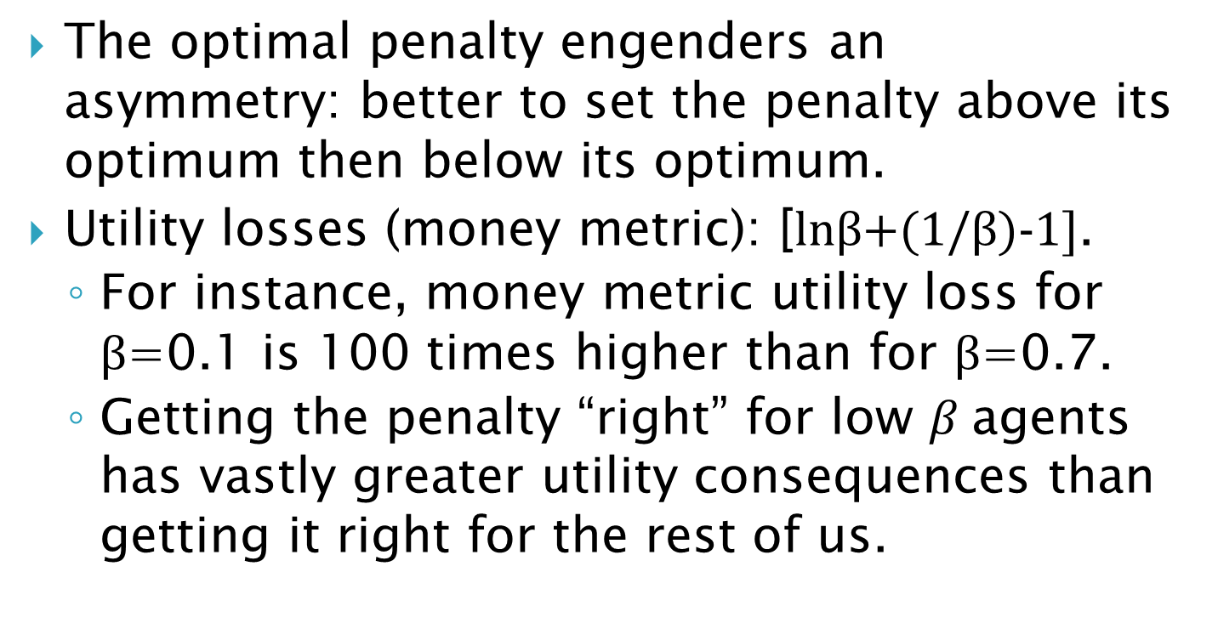
Two key properties
The optimal penalty engenders an asymmetry: better to set the penalty above its optimum then below its optimum.
  Utility losses (money metric): [lnβ+(1/β)-1].
  For instance, money metric utility loss for β=0.1 is 100 times higher than for β=0.7.
  Getting the penalty “right” for low $β$agents has vastly greater utility consequences than getting it right for the rest of us.

Slide 21
Consequently, completely illiquid retirement accounts are optimal if there is substantial heterogeneity in β.

Slide 22
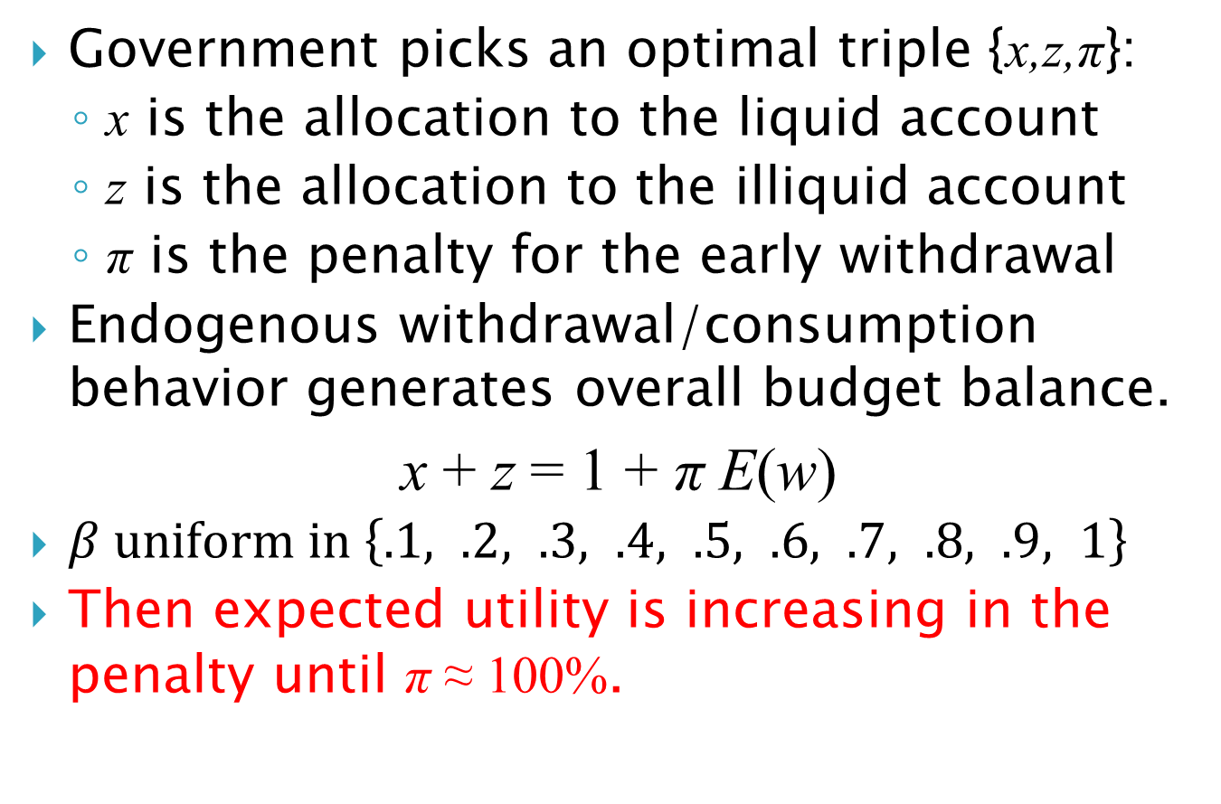
Numerical result:
Government picks an optimal triple {x,z,π}:
  x is the allocation to the liquid account
  z is the allocation to the illiquid account
  π is the penalty for the early withdrawal
Endogenous withdrawal/consumption behavior generates overall budget balance.
x + z = 1 + π E(w)
$β uniform in \left\{.1, .2, .3, .4, .5, .6, .7, .8, .9, 1\right\}$
Then expected utility is increasing in the penalty until π ≈ 100%.

Slide 23
Expected Utility For Each β Type
β=1.0
β=0.9
β=0.8
β=0.7
β=0.6
β=0.5
β=0.4
β=0.3
β=0.2
β=0.1
Penalty for Early Withdrawal

Slide 24
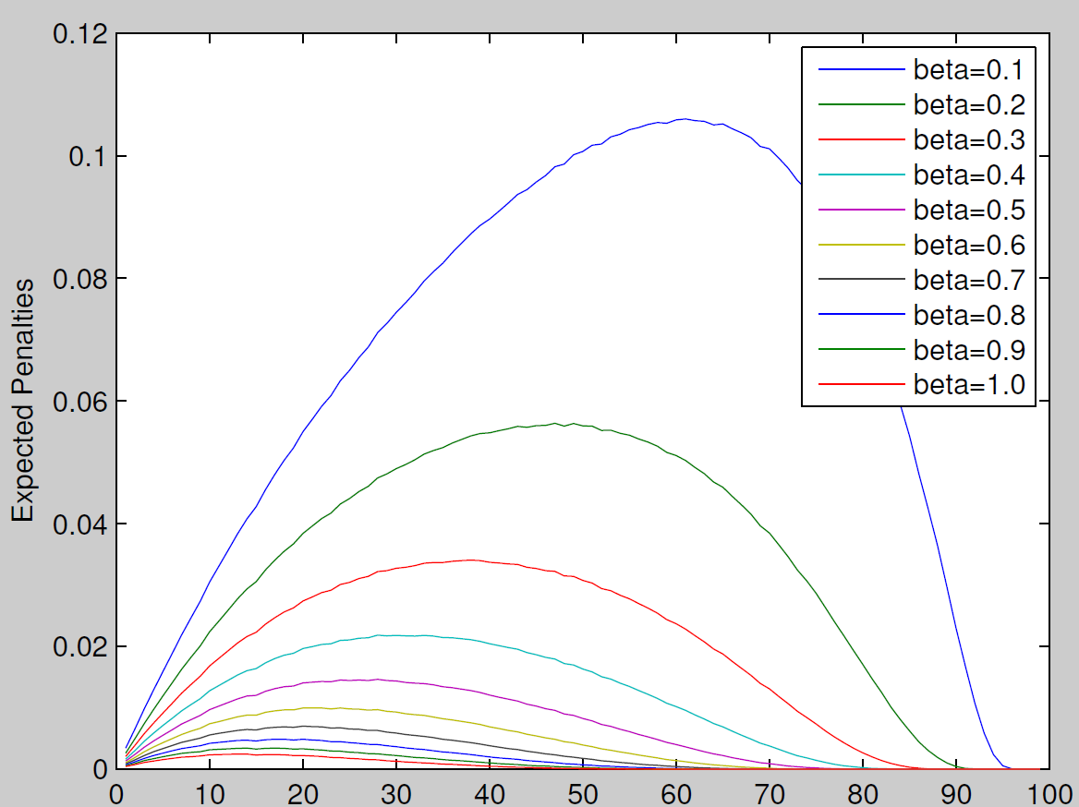
Expected Penalties Paid For Each β Type
Penalty for Early Withdrawal

Slide 25
Expected Utility For Each β Type
β=1.0
β=0.9
β=0.8
β=0.7
β=0.6
β=0.5
β=0.4
β=0.3
β=0.2
β=0.1
Penalty for Early Withdrawal

Slide 26
Expected Utility For Total Population
Penalty for Early Withdrawal

Slide 27
Conclusions and extensions
Our simple model suggests that optimal retirement systems may be characterized by a highly illiquid retirement account.
Almost all countries in the world have a system like this: A public social security system plus illiquid supplementary retirement accounts (either DB or DC or both).
The U.S. is the exception – defined contribution retirement accounts that are almost liquid.
We need more research to evaluate the optimality of liquidity and leakage in the US system.

