Slide 1
Does Social Security Continue to Favor Couples? by Karamcheva, Wu and Munnell
Discussion by Jeffrey R. Brown
University of Illinois and NBER
2014 RRC Meeting

Slide 2
Background
Long-standing interest among academics and policy makers regarding the extent to which OASI redistributes
Early 2000’s → flurry of high quality papers (by many people in this room) highlighting the complexity of the question
Three very important measurement issues:
Lifetime vs. annual income
Differential life expectancy
Household vs. individual income
Low income person part of high income couple
Spousal benefit calculations
Actual vs. potential income
Treating labor force non-participation as a choice

Slide 3
Simplified Summary of Prior Research
It is obvious that non-linear PIA formula redistributes from high to low income individuals in cross-section
ISpousal and survivor benefits lead to redistribution from singles and two-earner couples to single-earner couples
But redistribution is substantially less well-targeted (and maybe non-existent) when consider more expansive measures
Lifetime
Household
Potential income

Slide 4
KWM’s Contribution
Recognizes the very substantial trends in female labor force participation
Early Depression babies → 37% LFP at ages 24-35
Generation X → 73% LFP at age 24-35
And marital status among 55-64
70% of Depression babies
56% of those born in late 1960s (projected)
They show that the first of these (female LFP) matters a lot
The second matters, but less so

Slide 5
KWM Methods
This draft is still a work in progress
But research plan is very well designed & builds on prior literature
KWM do out of sample validation of MINT by using HRS with matched SS earnings records
KWM consider four measures of redistribution from prior literature
Benefit / tax ratio
Lifetime net tax rate
Share with negative tax rate / positive transfers
Effective progression (change in Gini coefficient)
KWM make good use of Oaxaca-Blinder decomposition to understand drivers of changes over time
Lots of sensitivity analysis

Slide 6
Three Broad Findings from KWM
On individual level, there are still transfers from men to women, but this is decreasing over time
On HH level, there are still transfers toward single-earner couples, but less so over time
Decomposition analysis indicates that a majority of the changes across cohorts is explained by increased labor force activity of women

Slide 7
Tools Allow Broader Questions
On average, KWM are finding important changes across cohorts in measures of “how good of a deal is OASI” for various groups?
Partly due to financing effects (average deal is getting worse)
But also changing extent of redistribution within cohorts
Broader question of interest: How efficiently is Social Security redistributing to those most in need?
Note: Ability to redistribute on a lifetime basis means that Social Security has an advantage over an annual income tax
KWM analysis suggests reasons to be concerned about trends

Slide 8
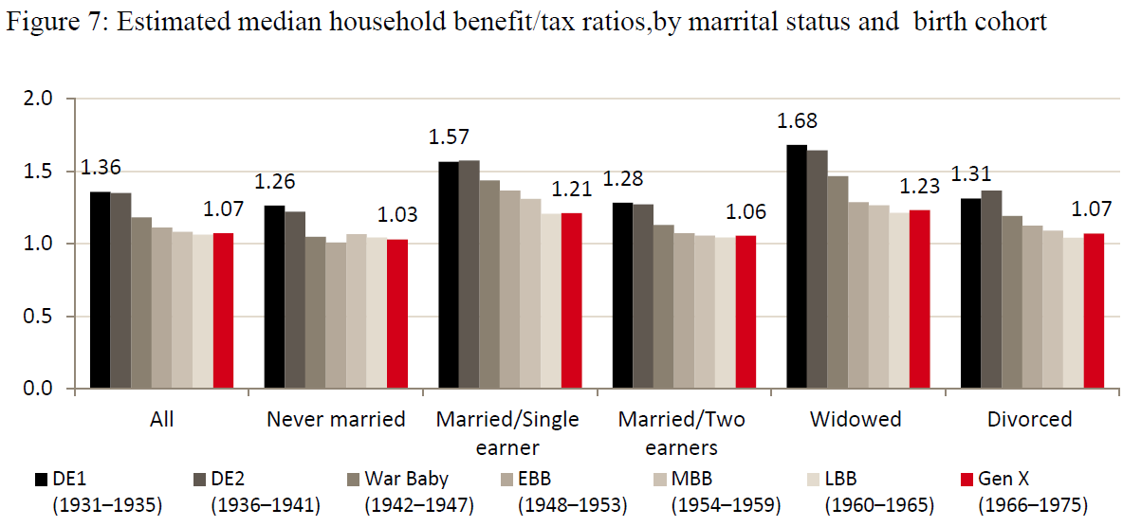
Treatment of Widows
Widows still have highest tax/benefit ratio, but much less so than in past. Should we be worried about this? Or, with rising female LFP will widows be less vulnerable in the future?

Slide 9
Policy Implications & Next Steps
Social Security’s treatment of spouses is becoming increasingly anachronistic as female labor force attachment increases
If we were designing a system from scratch, what might we do?
Earnings sharing between spouses?
Earnings credit for stay-at-home parents?
Minimum HH benefits to better address poverty?
Less revolutionary are proposals to at least better target existing spousal benefits
E.g., cap spousal benefit at ½ the median PIA to limit transfers to high-income single earner couples
Authors have developed a good toolkit, and they should use it to examine distributional implications of these and other policy ideas in future RRC-funded research!

