Slide 1
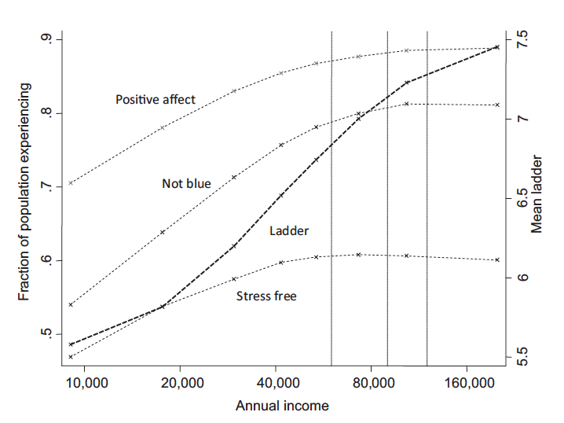
Comment: Does Working Longer Make You Happy?
John W. R. Phillips
National Institute on Aging
16th Annual Meeting of the Retirement Research Consortium
August 7-8, 2014
Comments do not necessarily reflect the views of the federal government.

Slide 2
Working Longer
Research has examined the factors the are associated with retirement (e.g. wealth, health, pensions/insurance systems)
Given improved healthy life expectancy, concerns about savings/pension changes and strain on social insurance systems, working longer seen as a way to improve economic well-being.
What about other dimensions of well-being? How can we tell, overall, how people are doing?

Slide 3
Perhaps we should consider more than economic measures…
“Gross National Product … counts air pollution, and cigarette advertising, … It does not allow for the health of our children, the quality of their education or the joy of their play… it measures everything, in short, except that which makes life worthwhile.”
Robert Kennedy, 1968

Slide 4
Subjective Well-Being
2009 Commission on the Measurement of Economic Performance and Social Progress
Governments should measure well-being to assess societal progress because market-based measures do not capture life quality
2013 National Research Council Study on Subjective Well-Being
SWB measures offer opportunity to improve understanding of factors that contribute to better lives
Assess the effects of events/policies without explicitly asking people to focus their attention on them
More surveys now include some measure of SWB

Slide 5
SWB Measures Related to Health and Economic Factors
Positive Affect Predicts
Reduced mortality
Maintenance of physical activity over time
Stroke recovery
Onset of frailty
Income and unemployment are two of the most important and reliable determinants of SWB
Unemployment exerts a larger negative influence than the associated reduction in income.
Importantly, SWB has shown people don’t like commuting with their bosses

Slide 6
Contribution of Paper
Use methods to address challenges identifying impact of retirement on SWB
SEM of retirement, income, SWB
Cross-national pension variation as IV
Use comparable measures from HRS and SHARE: life satisfaction and depression
Find retirement has a positive effect on life satisfaction

Slide 7
There Are Other Measures of Well-Being
Evaluative well-being: Global judgments of overall life satisfaction or purposeful engagement/personal growth
Experienced well-being: Reports of momentary positive and rewarding, or negative and distressing states connected to time-use/activities

Slide 8
Measures of Well-Being Capture Different Things
From NRC Report:
“Although life evaluation, positive experience, and negative experience are not completely separable—they correlate to some extent—there is strong evidence that multiple dimensions of SWB coexist. ExWB is distinctive enough from overall life evaluation to warrant pursuing it as a separate element in surveys; their level of independence demands that they be assessed as distinct dimensions.”

Slide 9
Evaluative Measures
On a scale from 0 to 10 where 0 means completely dissatisfied and 10 means completely satisfied, how satisfied are you with your life?
I have a sense of direction and purpose in my life.

Slide 10
Experience-Based Measures
Instruct respondent to focus on activities
How did you feel when you were working or volunteering?
Happy?
Frustrated?
Bored?
Pain?
Interested?
Etc.

Slide 11
Annual income tracks evaluative well-being; little impact on experienced well-being over $75,000
Kahneman, D. & Deaton, A. High income improves evaluation of life but not emotional well-being. PNAS, 2010.

Slide 12
Why Does 71 Year-Old Roger Work?
“I just realized that in order to have a sense of well-being, I needed to be engaged in something that made a difference to people,”
Source: Squared Away Blog, “A Short-Lived Retirement”

Slide 13
Future Directions
Consider other measures to capture different dimensions of SWB as these may vary importantly over a diverse older population
Longitudinal transitions (work/retirement) could be very informative
HRS, ELSA and SHARE all adopted (or are adopting) comparable experience-based measures to compliment evaluative measures
Can inform about non-economic benefits of extending the work life – work keeps people socially engaged (prevents loneliness/SI) , cognitively engaged (slows ARCD), etc.

