Slide 1
Retirement Lock and Prescription Drug Insurance: Evidence from Medicare Part D
Discussant: Lauren Schmitz
University of Michigan
Retirement Research Consortium Meeting
August 3, 2017

Slide 2
Do Americans work in order to maintain health benefits at older ages?
Yes → paper finds solid evidence of retirement lock
Workers reliant on their employer for prescription drug coverage worked less after gaining access to prescription drug insurance through Medicare Part D
Growing empirical support across multiple studies that health insurance affects retirement decisions (e.g. Gruber & Madrian, 2004)
Very important work → difficult to unravel the independent effect of health insurance on the decision to continue working at older ages
Decision to work or retire is complex
Need to broaden our understanding of the link between health insurance and labor supply, particularly given the passage of the ACA

Slide 3
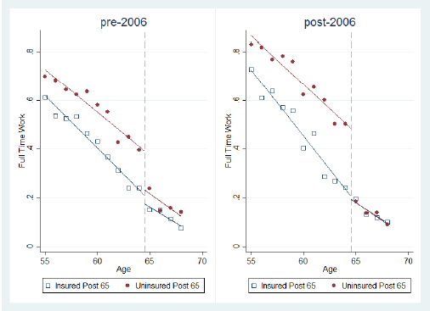
Quasi-natural experiment causally associates health insurance with labor supply
Treatment group reduced their rate of full-time work by 8.4 percentage points more after 2006 than they did before 2006
Treatment group: only covered by an employer retirement health plan up to age 65
Control group: covered before and after age 65 (i.e. not affected by Medicare Part D)

Slide 4
Is job lock prevalent in the U.S.?
“Right now, would you like to leave work altogether, but plan to keep working because you need the health insurance?”
N=7,228; Source: Health and Retirement Study (HRS) Psychosocial and Lifestyle Questionnaire
(2008, 2012, 2014); estimates are weighted to adjust for complex sampling design.
Notes:
Research shows access to health care is an important determinant of the retirement process

Slide 5
Workers under age 65 report more job lock
N=7,228; Source: Health and Retirement Study (HRS) Psychosocial and Lifestyle Questionnaire
(2008, 2012, 2014); estimates are weighted to adjust for complex sampling design.

Slide 6
Is job lock really a problem?
May encourage individuals to work longer→ increase individual retirement savings and government tax revenue
Job lock is an indicator of job dissatisfaction and a preference for retirement
A person can only be job locked if they have to continue working—i.e. they feel “pushed” to continue working for financial or other economic reasons
High prevalence of job lock among aging workers is a problem if we want to extend the working life → implies that a high proportion of workers do not want to continue working
Could have potential negative consequences for life satisfaction and worker well-being (Fisher, Ryan, Sonnega, and Naudé, 2016)

Slide 7
What types of workers are more likely to experience job lock?
In the HRS, job lock is more prevalent among minority workers and workers with lower socioeconomic status
These are workers who also tend to have less desirable working conditions (e.g. more physical demands, harsher environmental conditions, and less autonomy)
Workers in poorer health are also more likely to report that they are job locked

Slide 8
Minority workers report more job lock
N=7,228; Source: Health and Retirement Study (HRS) Psychosocial and Lifestyle Questionnaire
(2008, 2012, 2014); estimates are weighted to adjust for complex sampling design.

Slide 9
Blue collar and service workers report more job lock than white collar workers
N=7,228; Source: Health and Retirement Study (HRS) Psychosocial and Lifestyle Questionnaire
(2008, 2012, 2014); estimates are weighted to adjust for complex sampling design.

Slide 10
Less educated workers report more job lock
Highest degree obtained
N=7,228; Source: Health and Retirement Study (HRS) Psychosocial and Lifestyle Questionnaire
(2008, 2012, 2014); estimates are weighted to adjust for complex sampling design.

Slide 11
Workers with job lock have lower household income
N=7,228; Source: Health and Retirement Study (HRS) Psychosocial and Lifestyle Questionnaire
(2008, 2012, 2014); estimates are weighted to adjust for complex sampling design.

Slide 12
Job locked workers have less household wealth
N=7,228; Source: Health and Retirement Study (HRS) Psychosocial and Lifestyle Questionnaire
(2008, 2012, 2014); estimates are weighted to adjust for complex sampling design.

Slide 13
Workers in worse health report more job lock
N=7,228; Source: Health and Retirement Study (HRS) Psychosocial and Lifestyle Questionnaire
(2008, 2012, 2014); estimates are weighted to adjust for complex sampling design.

Slide 14
Job lock is negatively related to the psychological well-being of workers
Recent work suggests job lock is negatively associated with life satisfaction and earlier retirement (Fisher et al., 2016)
Job locked individuals are more likely to rate their psychosocial work environment as worse than the corresponding O*NET score for their occupation (controlling for a wide range of factors) (Schmitz et al., 2017)
Job locked individuals perceive that they have lower opportunities for advancement, less recognition for the work they do, less decision freedom, and less autonomy/control over their day-to-day workload than predicted by the O*NET rating
Negative relationship between job lock, well-being, and perceived control over one’s work situation

Slide 15
More research on job lock is needed
Job lock is a highly prevalent phenomenon among aging U.S. workers
Economic concept that is related to job attitudes and worker well-being
Better understand the relative importance of psychological and financial factors in motivating the retirement decision
Can’t change financial circumstances of individuals but we may be able to improve their perception of work through small changes to their work environment
Can the alleviation of job lock actually improve worker perception earlier in the life course, motivating longer working lives?
Have perceptions of job lock decreased as a result of the ACA and is this associated with improved worker well-being and labor force participation?
Research (like Gal’s) that can exploit quasi-experimental variation along these lines is particularly valuable for retirement policy

Slide 16
Thank you!

