Slide 1
How Do Shocks to Pension Wealth Affect Pension Claiming and Labor Supply?
Rafael Lalive
University of Lausanne
and CEPR
Arvind Magesan
University of Calgary
Stefan Staubli
University of Calgary
and NBER
Retirement Research Consortium Annual Conference
Washington DC, August 2017
NBER (SSA) funding gratefully acknowledged
Lalive, Magesan and Staubli
Pension Wealth
1 / 20

Slide 2
Motivation
Retirement programs are among the largest social insurance programs
Full pension only at the full retirement age (FRA)
Recently, many countries are raising FRA to address insolvency
Lalive, Magesan and Staubli
Pension Wealth
2 / 20

Slide 3
Research Question
Raising FRA can affect behavior through two channels:
Financial incentive by cutting pensions
Shifting of reference point
Exploit a pension reform for women in Switzerland
FRA is the default claiming age
Reform provides variation in default and financial incentives
How do people adjust pension claiming and retirement?
Lalive, Magesan and Staubli
Pension Wealth
3 / 20

Slide 4
Swiss Old Age and Survivors Insurance (OASI) I Contribution history and average earnings over the lifetime I Net replacement rate around 30%
Net replacement rate of around 30%
FRA before 2001: 62 for women and 65 for men
Early claiming not possible
Late claiming possible but rate
Lalive, Magesan and Staubli
Pension Wealth
4 / 20

Slide 5
The OASI reform for women
Increase FRA but only small pension cut if claim early
FRA to 63: cut by 3.4% if claim at 62 and born 1939-1941
FRA to 64: cut by 3.4% per year early if born 1942 or after
Large pension cut if claim before FRA but no change in FRA
Pension cut by 6.8% per year early if born 1948 or after
How to claim?
Inform agency before early claiming age, otherwise claim at FRA
Lalive, Magesan and Staubli
Pension Wealth
5 / 20

Slide 6
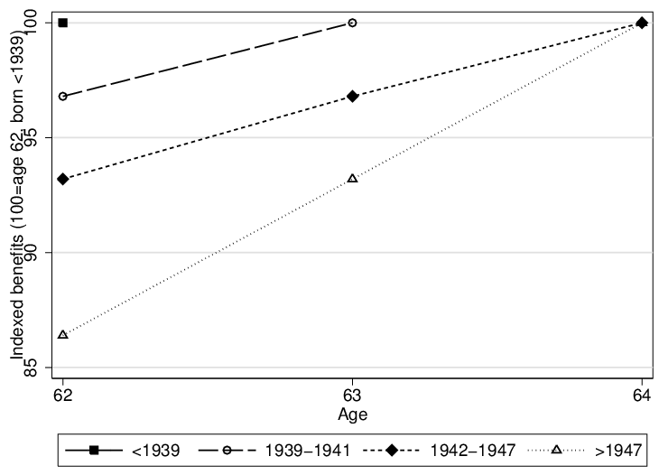
Generosity of OASI Pensions
Lalive, Magesan and Staubli
Pension Wealth
6 / 20

Slide 7
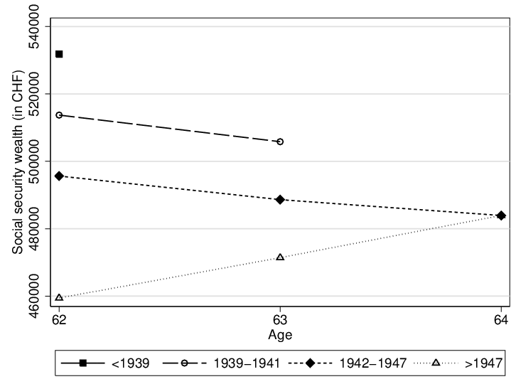
Social Security Wealth
Lalive, Magesan and Staubli
Pension Wealth
7 / 20

Slide 8
FRA 63 and FRA 64: What should happen?
Pension claiming
Because actuarially unfair on average → claim early
Because of shifted default → delay claiming
Retirement
Because of negative wealth shock → retire later
Lalive, Magesan and Staubli
Pension Wealth
8 / 20

Slide 9
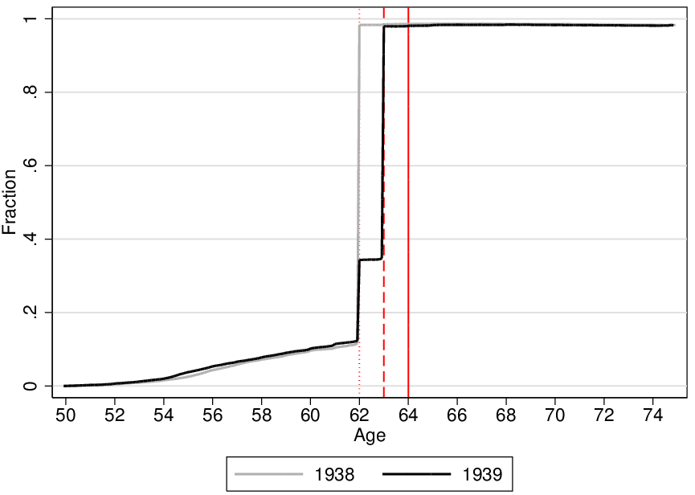
FRA 63: Claiming profile (OASI and disability)
Lalive, Magesan and Staubli
Pension Wealth
9 / 20

Slide 10
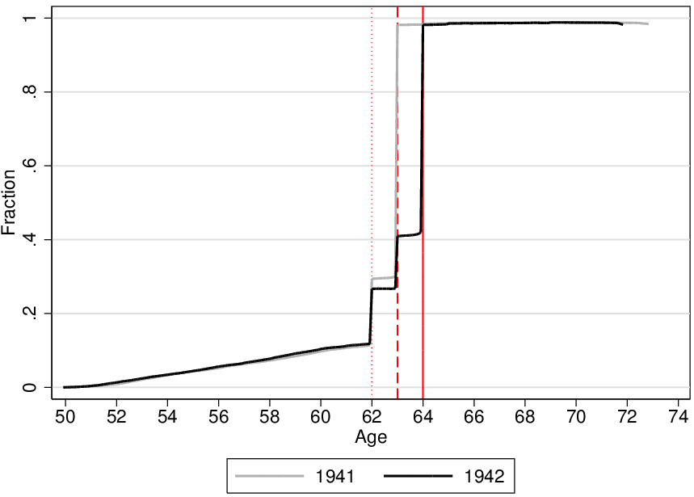
FRA 64: Claiming profile (OASI and disability)
Lalive, Magesan and Staubli
Pension Wealth
10 / 20

Slide 11
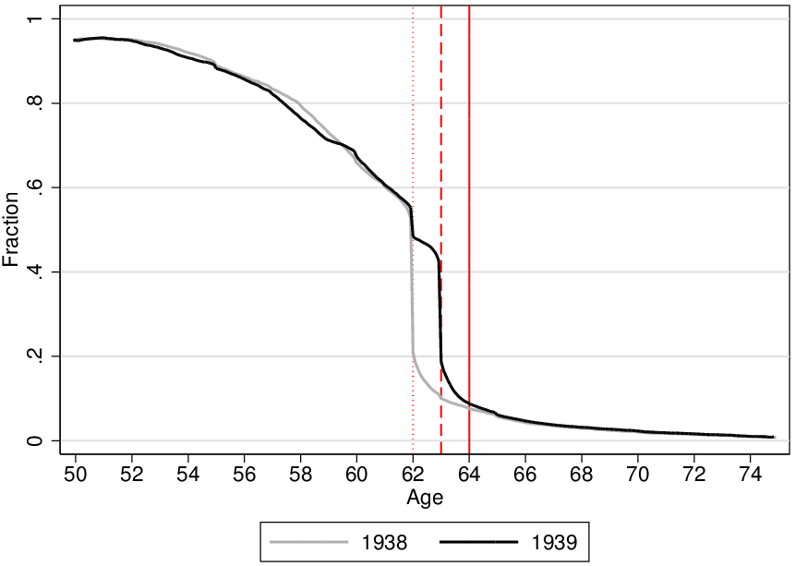
FRA 63: Employment profile
Lalive, Magesan and Staubli
Pension Wealth
11 / 20

Slide 12
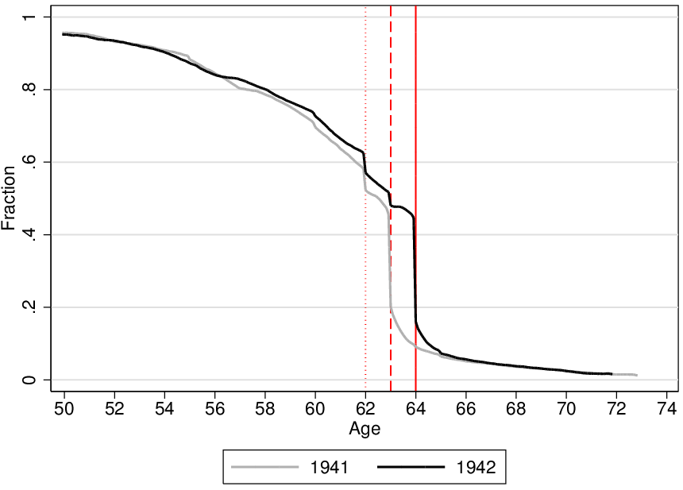
FRA 64: Employment profile
Lalive, Magesan and Staubli
Pension Wealth
12 / 20

Slide 13
RAF: What should happen?
Pension claiming
Because actuarially more than fair on average → delay claiming
Because no shift in default → no effect
Retirement
Can undo wealth shock if delay claiming → no effect
Lalive, Magesan and Staubli
Pension Wealth
13 / 20

Slide 14
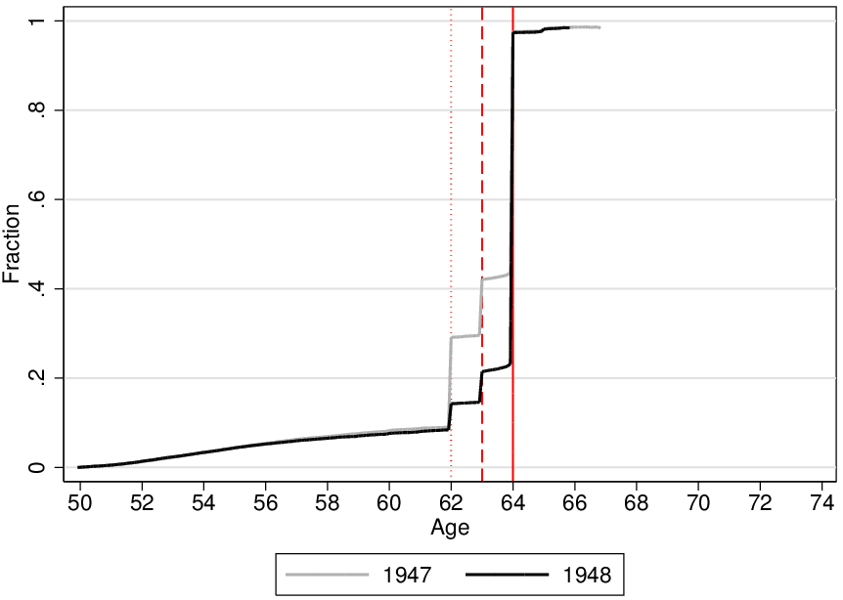
RAF: Claiming profile (OASI and disability)
Lalive, Magesan and Staubli
Pension Wealth
14 / 20

Slide 15
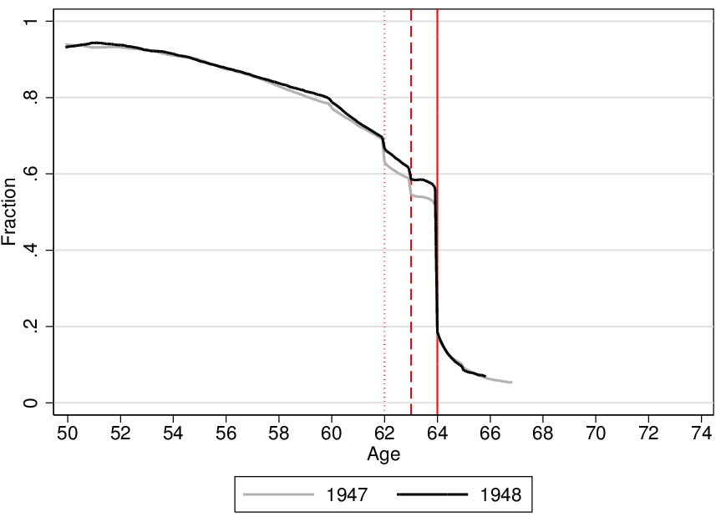
RAF: Employment profile
Lalive, Magesan and Staubli
Pension Wealth
15 / 20

Slide 16
Birth Date Regression Discontinuity Design (RDD)
Exploit discontinuities in FRA 63/FRA 64/RAF by birth date
Treatment groups: women born in 1939/1942/1948
Control groups: women born in 1938/1941/1947
Lalive, Magesan and Staubli
Pension Wealth
16 / 20

Slide 17
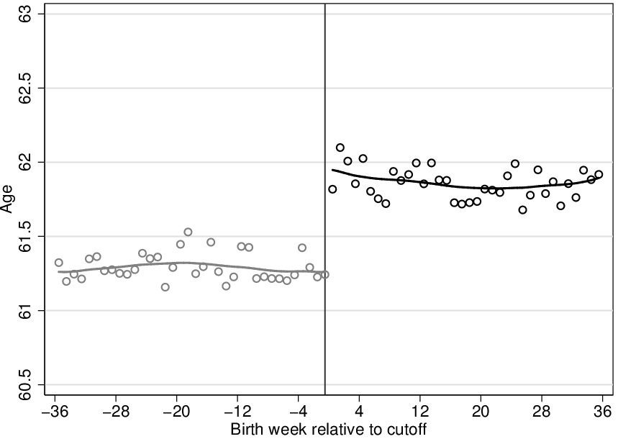
FRA 63: Effect on women's claiming age
Lalive, Magesan and Staubli
Pension Wealth
17 / 20

Slide 18
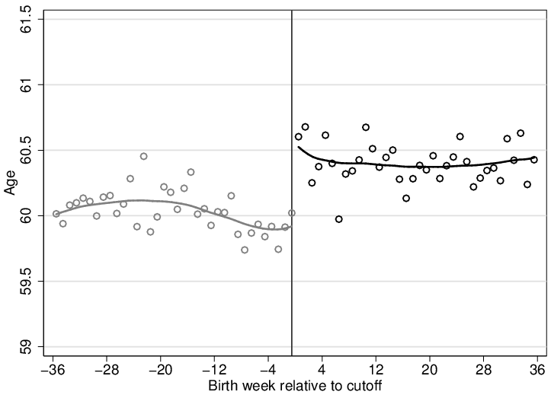
FRA 63: Effect on women’s retirement age
Lalive, Magesan and Staubli
Pension Wealth
18 / 20

Slide 19
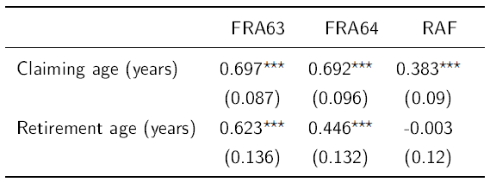
Main estimates
Lalive, Magesan and Staubli
Pension Wealth
19 / 20

Slide 20
Summary
Exploit interesting pension reform in Switzerland
Reform affects behavior (mainly) through two channels:
Financial incentives
Shifting of default option
Empirical evidence suggests that default plays important role
Defaults: powerful but can mask the best choice
Lalive, Magesan and Staubli
Pension Wealth
20 / 20

