Slide 1
Work-Life Balance and Labor Force Attachment at Older Ages
Marco Angrisani
(USC, Center for Economic and Social Research)
Maria Casanova
(California State University, Fullerton and USC-CESR)
Erik Meijer
(USC, Center for Economic and Social Research)
19th Annual Meeting of the Retirement Research Consortium
Washington DC, August 3-4, 2017

Slide 2
Introduction and Motivation
Recent demographic trends have raised concerns about the long-term sustainability of Social Security programs.
As a result, increasing older workers' attachment to the labor force is at the top of policy makers' agenda in most developed economies.
In this scenario, it is of critical importance to:
Study labor supply decisions at older ages.
Identify what shapes observed retirement paths.

Slide 3
Introduction and Motivation
Work-life balance (WLB) is defined as the absence of conflict between work and non-work activities.
A growing literature has identified in WLB a key determinant of workers' evaluation of the relative attractiveness of work versus leisure, particularly at older ages.
Yet, the extent to which the degree of perceived WLB influences labor supply decisions remains to be established and quantified.

Slide 4
Aims
We aim to fill this gap by:
Estimating the effect of WLB on older workers' employment transitions.
Investigating to what extent WLB moderates labor supply responses to spousal health shocks.
A better understanding of the effect of WLB on retirement behavior, and of the specific life circumstances during which WLB becomes valuable to individuals, provides a policy handle to promote working at older ages.

Slide 5
Analysis
We use HRS data over the period 2006-2014.
We consider workers age 50-79 (excluding those self-employed, disabled, unemployed and out of the labor force).
To approximate the variety of retirement paths observed among older American workers in recent years, we estimate separate multinomial discrete choice models for the following wave-to-wave transitions:
FT PT PT FT
FT Ret PT Ret
Recognizing the existence of potential gender differences in the
preference for work versus leisure, as well as in the perception of WLB, we separately estimate our models for men and women.

Slide 6
Analysis
The potential conflict between work and life is bi-directional and better captured by subjective perceptions rather than by objective indicators (e.g., number of hours worked, work loads).
We jointly account for individual self-reported measures of:
Work strains that affect private life negatively:
Work-Life Interference or WLI (questions)
Aspects of private life that negatively impact productivity or work (dis)utility:
Life-Work Interference or LWI (questions)

Slide 7
Results (I) ─ Male Workers
Observed transitions:
7% 14%
FT PT PT FT
13% 22%
80% 64%
FT Ret PT Ret
Effect of WLB on Employment Transitions
 | Transition from FT To: |  |  | Transition from PT To:
 | FT | PT | Ret | FT | PT | Ret
WLI | -0.013 | 0.001 | 0.012 | 0.011 | -0.071*** | 0.059***
LWI | -0.007 | 0.007 | -0.000 | -0.022 | 0.046* | -0.024

Slide 8
Results (I) ─ Female Workers
Observed transitions:
10% 12%
FT PT PT FT
14% 20%
76% 68%
FT Ret PT Ret
Effect of WLB on Employment Transitions
 | Transition from FT To: |  |  | Transition from PT To:
 | FT | PT | Ret | FT | PT | Ret
WLI | -0.020** | -0.002 | 0.022*** | 0.003 | -0.049*** | 0.046***
LWI | -0.009 | 0.008 | 0.001 | -0.014 | 0.030* | -0.016

Slide 9
Results (II)
A prime example of a situation in which WLB may tip the scales in favor of continued employment or retirement is when an individual's spouse experiences a health shock.
We investigate to what extent labor supply responses to a spouse's health shock vary with the level of perceived WLB.
We focus on the WLI index interacted with an indicator for whether the spouse suffers an acute health issue (health problems, stroke, cancer) or is newly diagnosed with a chronic condition (lung disease, diabetes, high blood pressure, arthritis, psychological problems) across two consecutive waves.

Slide 10
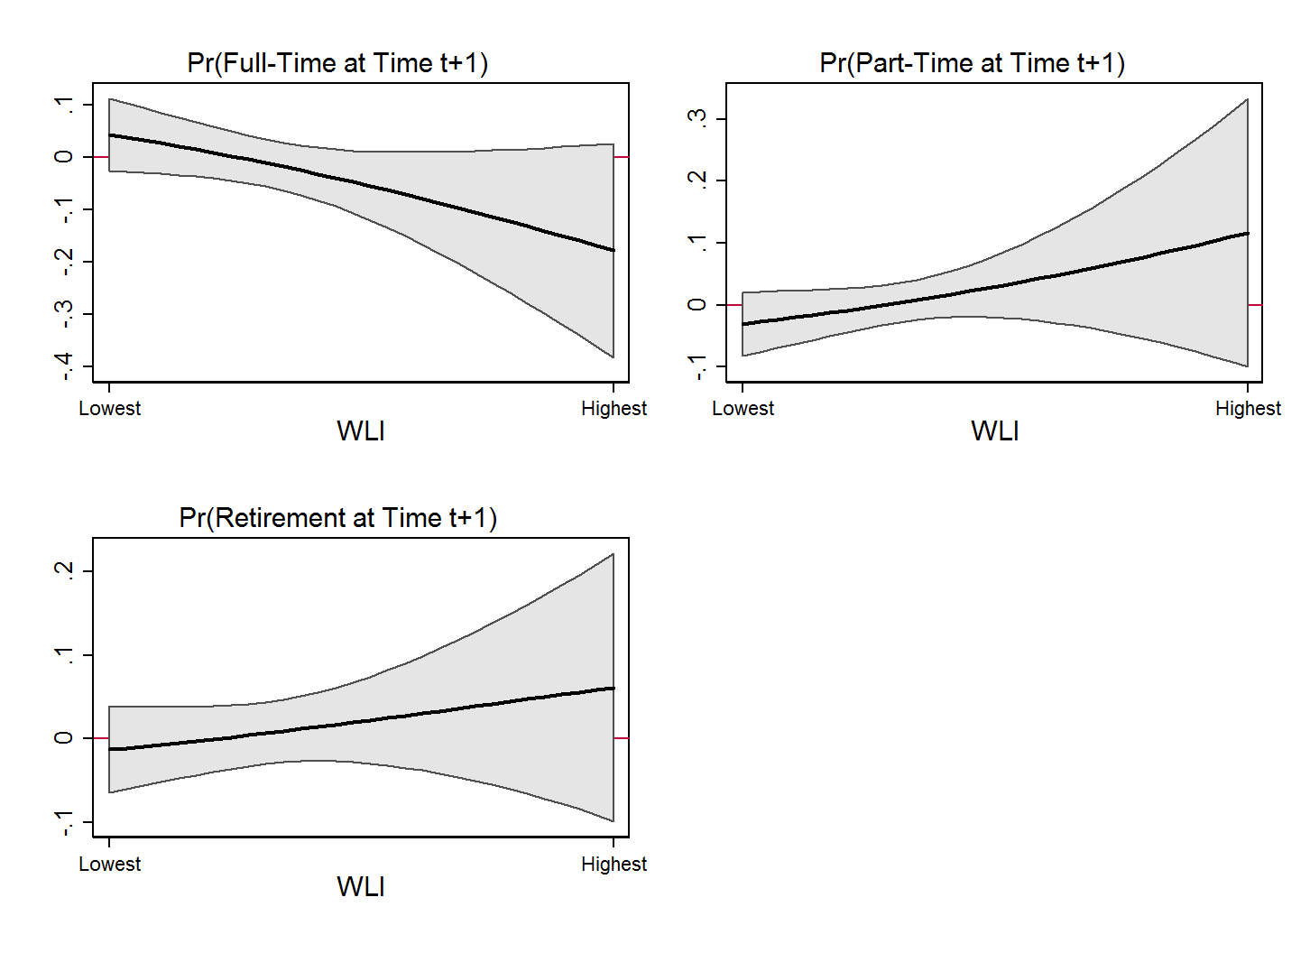
Results (II) ─ Full-Time Male Workers
Effect of a Spouse’s Health Shock on:

Slide 11
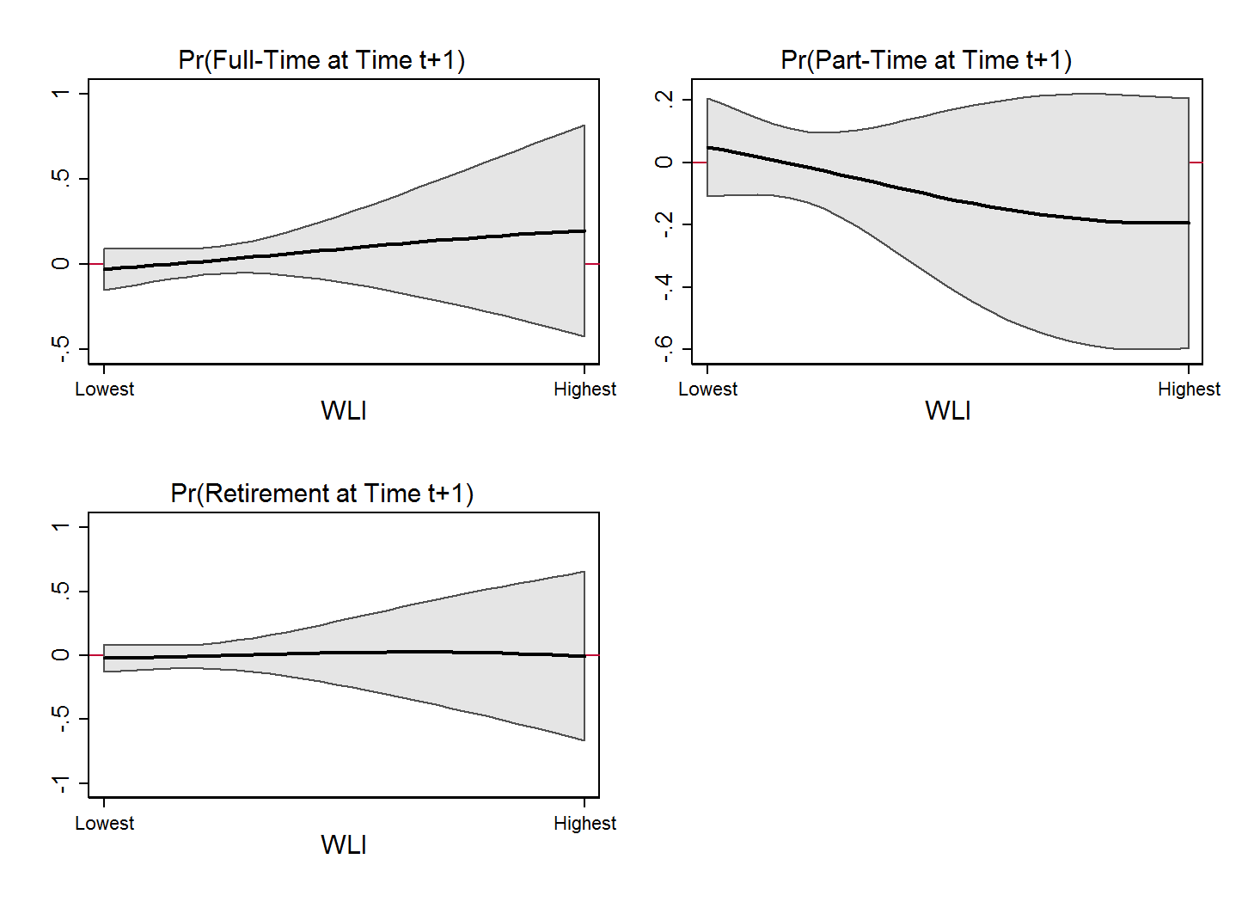
Results (II) ─ Part-Time Male Workers
Effect of a Spouse’s Health Shock on:

Slide 12
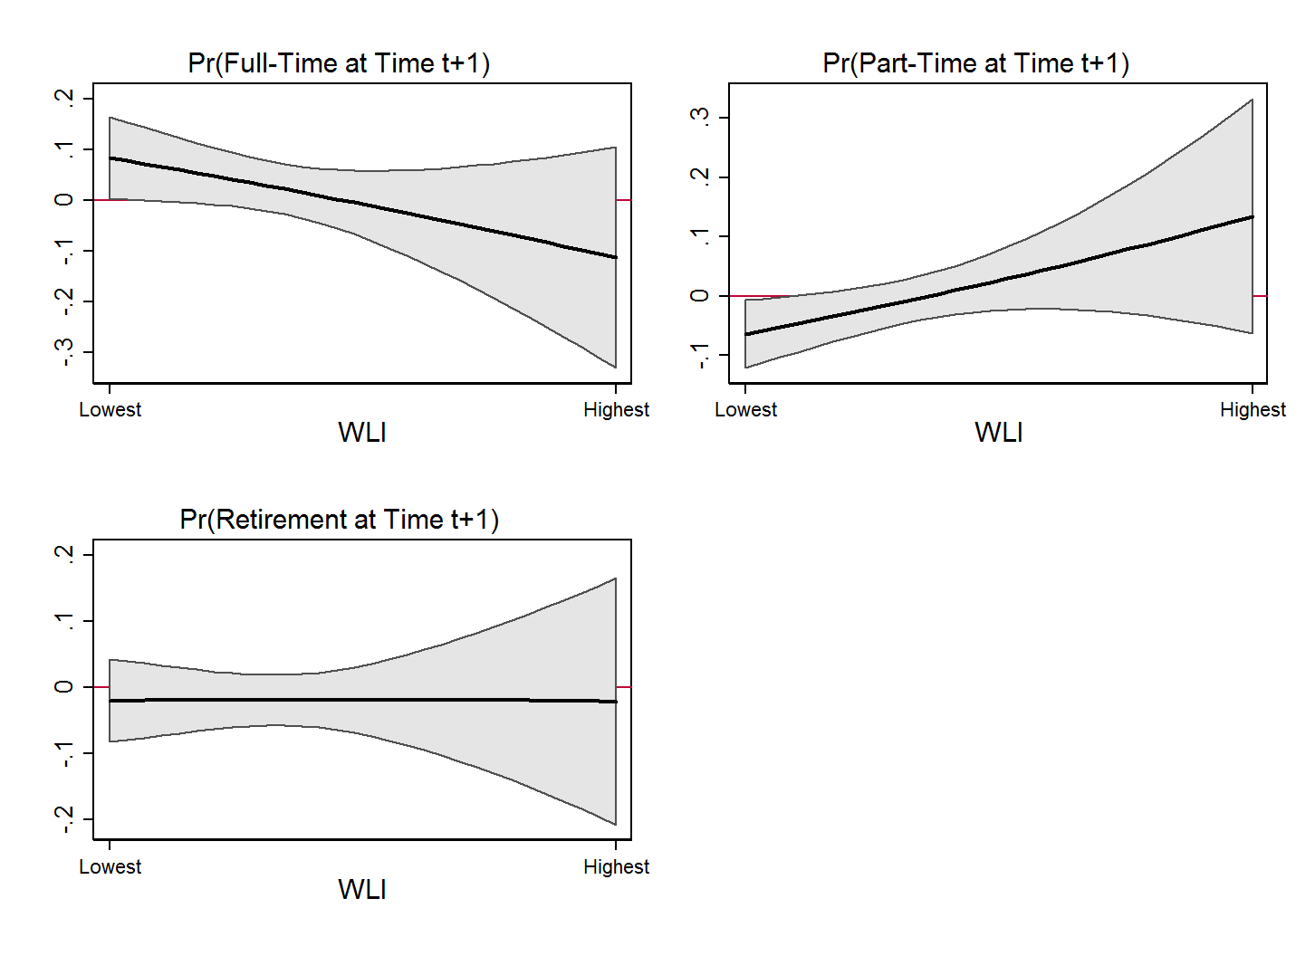
Results (II) ─ Full-Time Female Workers
Effect of a Spouse’s Health Shock on:

Slide 13
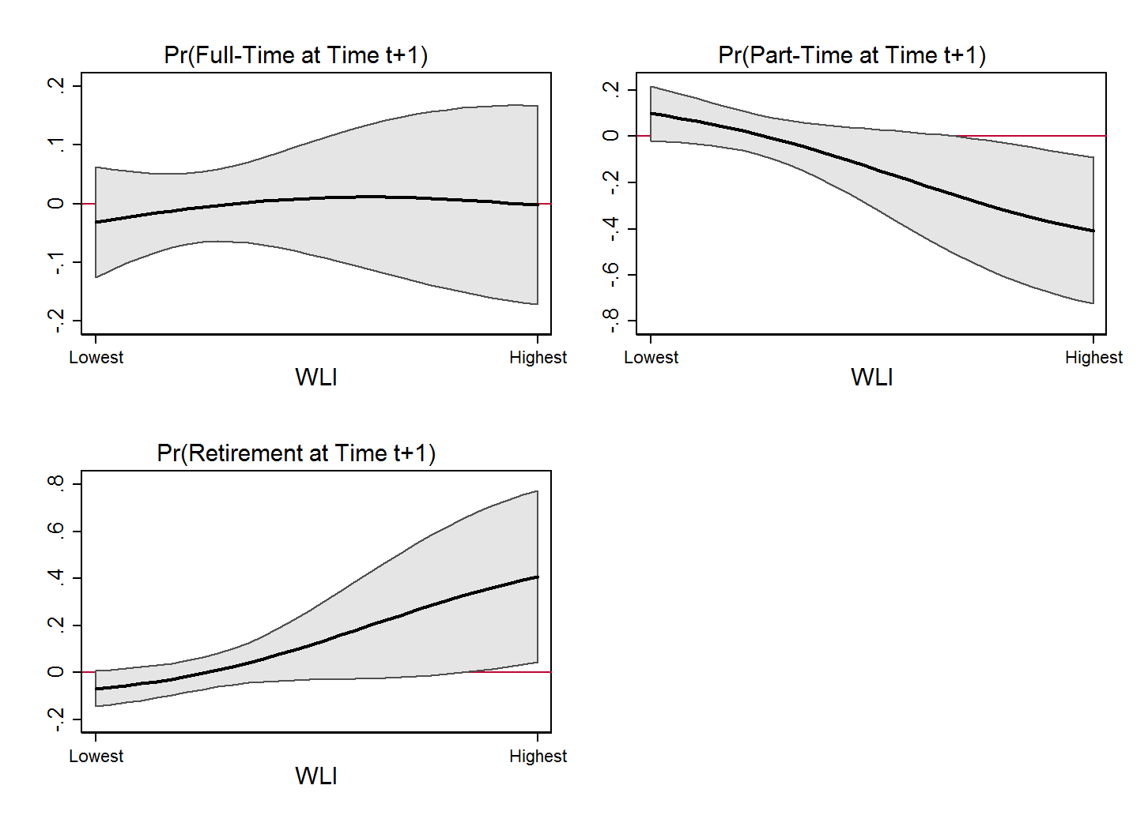
Results (II) ─ Part-Time Female Workers
Effect of a Spouse’s Health Shock on:

Slide 14
Summary (I)
WLB is significantly associated with employment transitions.
Such association is mainly driven by WLI, whereas LWI correlates only weakly with labor supply decisions of older workers.
There exists great heterogeneity in the response to perceived WLB by gender and employment status at baseline.
A one standard deviation increase in WLI increases the retirement probability by:
5.9 p.p. or 27% relative to sample average for male part-timers.
2.2 p.p. or 16% relative to sample average for female full-timers.
4.6 p.p. or 26% relative to sample average for female part-timers.

Slide 15
Summary (II)
WLB moderates labor supply responses to a spouse's health shock, and differentially so for men and women.
For each one standard deviation increase in WLI:
The probability that male full-timers remain in full-time after a spouse's health shock decreases by 4.2 p.p.
The probability that female full-timers switch to part-time after a spouse's health shock increases by 4 p.p.
The probability that female part-timers retire after a spouse's health shock increases by 8 p.p.

Slide 16
Concluding Remarks
Despite controlling for a wide array of variables that may affect both WLB and employment transitions, we cannot completely rule out that other, unobservable factors may drive our findings.
We argue that the influence of unobservable factors affecting selection into jobs with certain characteristics and levels of WLB as well as taste for work versus leisure would bias our estimates downward.
Thus, we interpret our results as suggestive of a causal, positive relation between WLB and prolonged attachment to the labor force.

Slide 17
Concluding Remarks
In future research, we plan to exploit policy changes affecting the work flexibility across states (e.g., recent paid family leave insurance laws in CA, NJ, RI and WA) to further assess the causal relationship between WLB and employment transitions.

Slide 18
Work-Life Interference Questions
Question No. | Question Text
LB048A | My work schedule makes it difficult to fulfill personal responsibilities
LB048B | Because of my job, I don't have the energy to do things with my family or other important people in my life
LB048C | Job worries or problems distract me when I am not at work
LB048G | My work leaves me enough time to attend to my personal responsibilities
LB048H | My work gives me energy to do things with my family and other important people in my life
LB048I | Because of my job, I am in a better mood at home
Questions are answered using the following 4-point scale:
1 = Rarely, 2 = Some times, 3 = Often, 4 = Most of the time.
back

Slide 19
Life-Work Interference Questions
Question No. | Question Text
LB048D | My home life keeps me from getting work done on time on my job
LB048E | My family or personal life drains me of the energy I need to do my job
LB048F | I am preoccupied with personal responsibilities while I am at work
LB048J | My personal responsibilities leave me enough time to do my job
LB048K | My family or personal life gives me energy to do my job
LB048L | I am in a better mood at work because of my family or personal life
Questions are answered using the following 4-point scale:
1 = Rarely, 2 = Some times, 3 = Often, 4 = Most of the time.
back

