Slide 1
How Long Should You Work?
Planning for a Secure Retirement
Presenter
Title
Organization
Conference Title
City, State
Month Day, Year

Slide 2
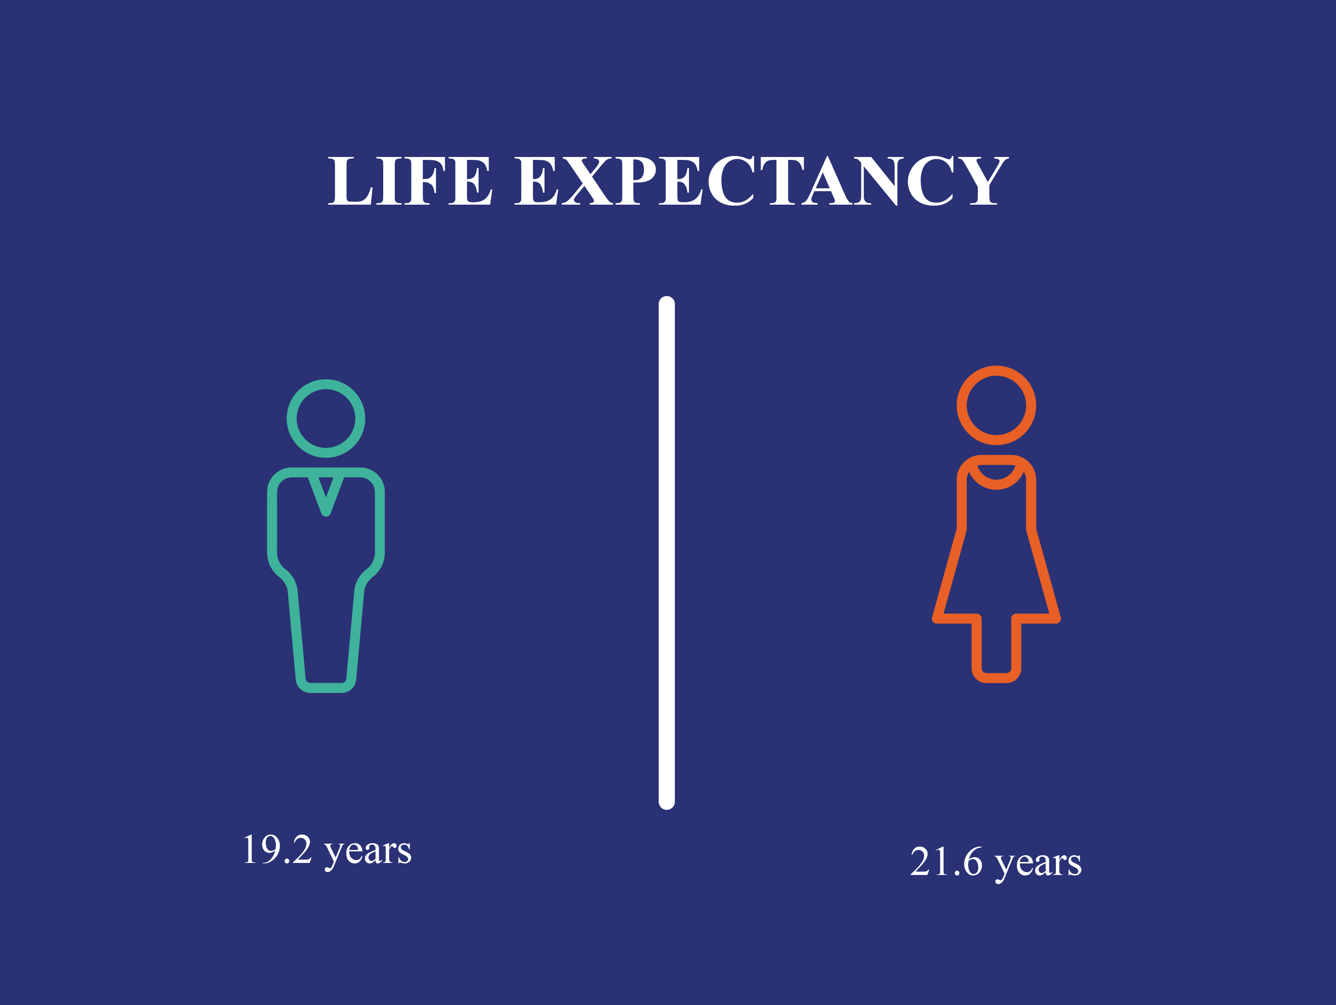
The good news: you have a long life ahead.
An Average Person at Age 65
Will Live 20 More Years
Chances That One Person in a
Married Couple Will Live To…
19.2 years
21.6 years
Source: U.S. Social Security Administration. 2018. Longevity Visualizer.
Notes:
Chances that at least one person in a married couple will lead a long life are even higher.
Out of 100 married couples at age 65:
91 will have at least one member alive at age 80;
78 will have at least one member alive at age 85;
54 will have at least one member alive at age 90; and
25 will have at least one member alive at age 95.

Slide 3
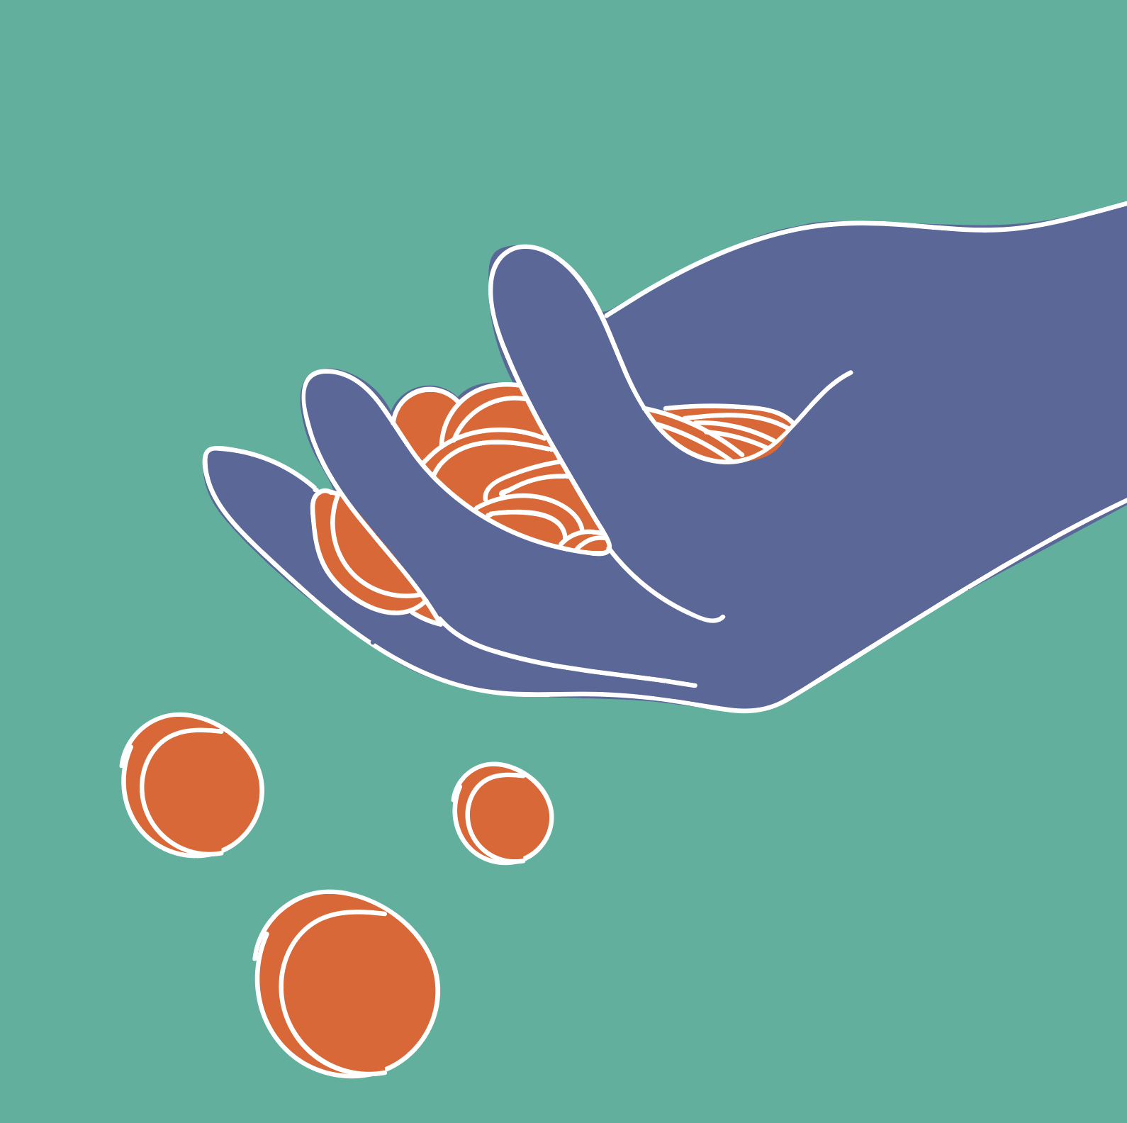
The bad news: without a paycheck, you will need a lot of money for a long retirement.

Slide 4
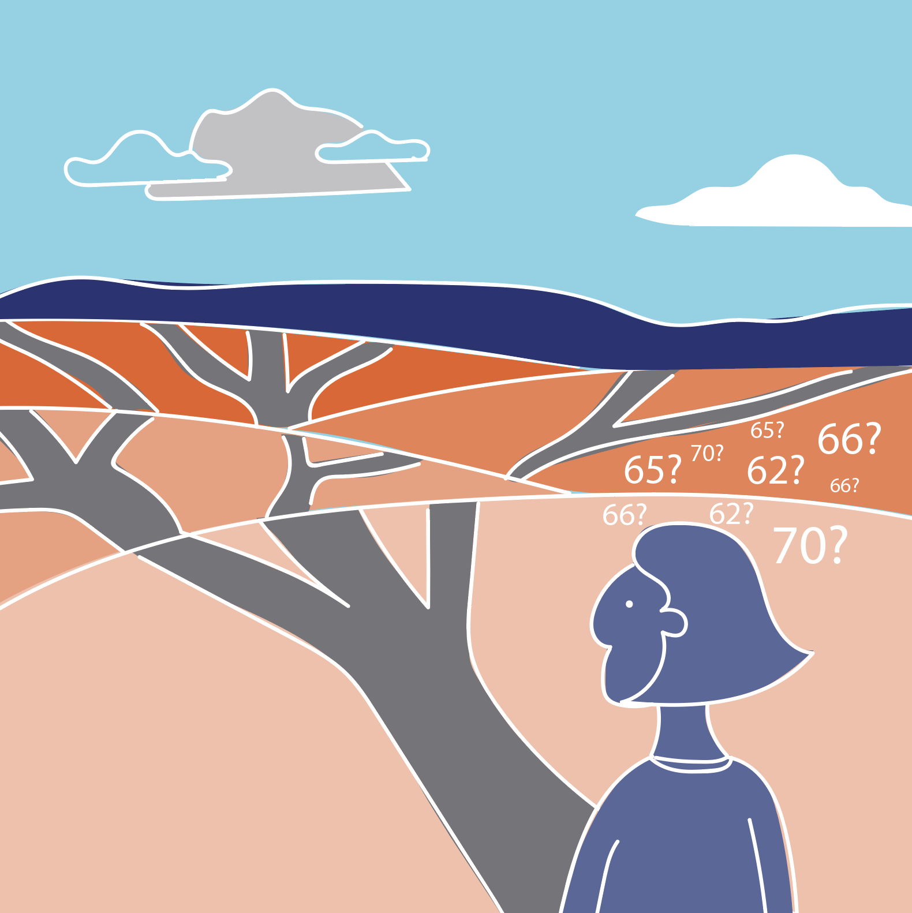
The age at which you retire is your most important financial decision.
Notes:
You can claim your Social Security benefit as early as age 62 or as late as age 70.
Your Full Retirement Age (FRA) is based on the year you were born. If you were born between 1943 and 1959, your FRA is 66 (with a gradual increase toward 67 for those born between 1955 and 1959). If you were born in 1960 or later, your FRA is 67.
If you claim at your FRA, you receive your full monthly benefit.
If you claim before your FRA, your monthly benefits are reduced based on how early you claim.
If you claim after your FRA, your monthly benefits are increased based on how late you claim.

Slide 5
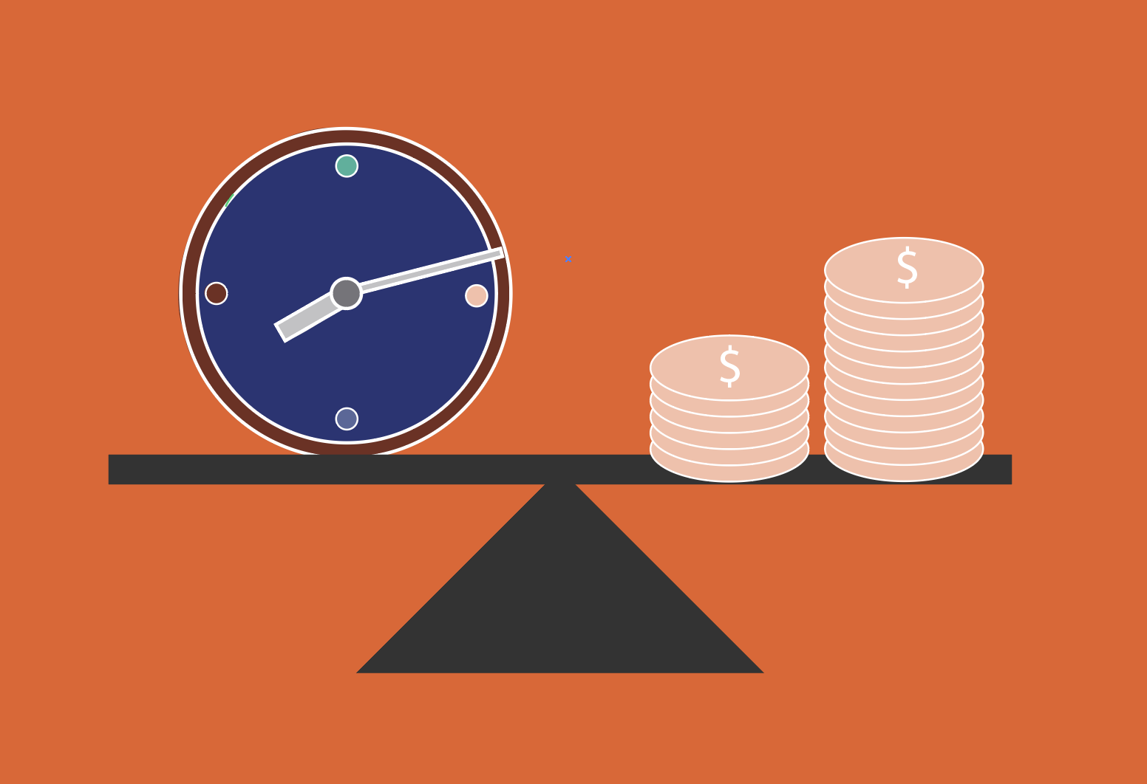
The first step in deciding when to retire is to figure out how much you need.
Typically, you need about 75 percent of your earnings because:
you will pay less in taxes;
you won’t need to save for retirement;
your mortgage may be paid off; and
your kids will be on their own.
Notes:
The first step in deciding when to retire is to figure out how much you need to maintain your standard of living.
Of course, this target is a rule of thumb. When figuring out how much you need, it is important to consider the cost of living in your area, health expenses, and how much money you have at the end of the month.

Slide 6
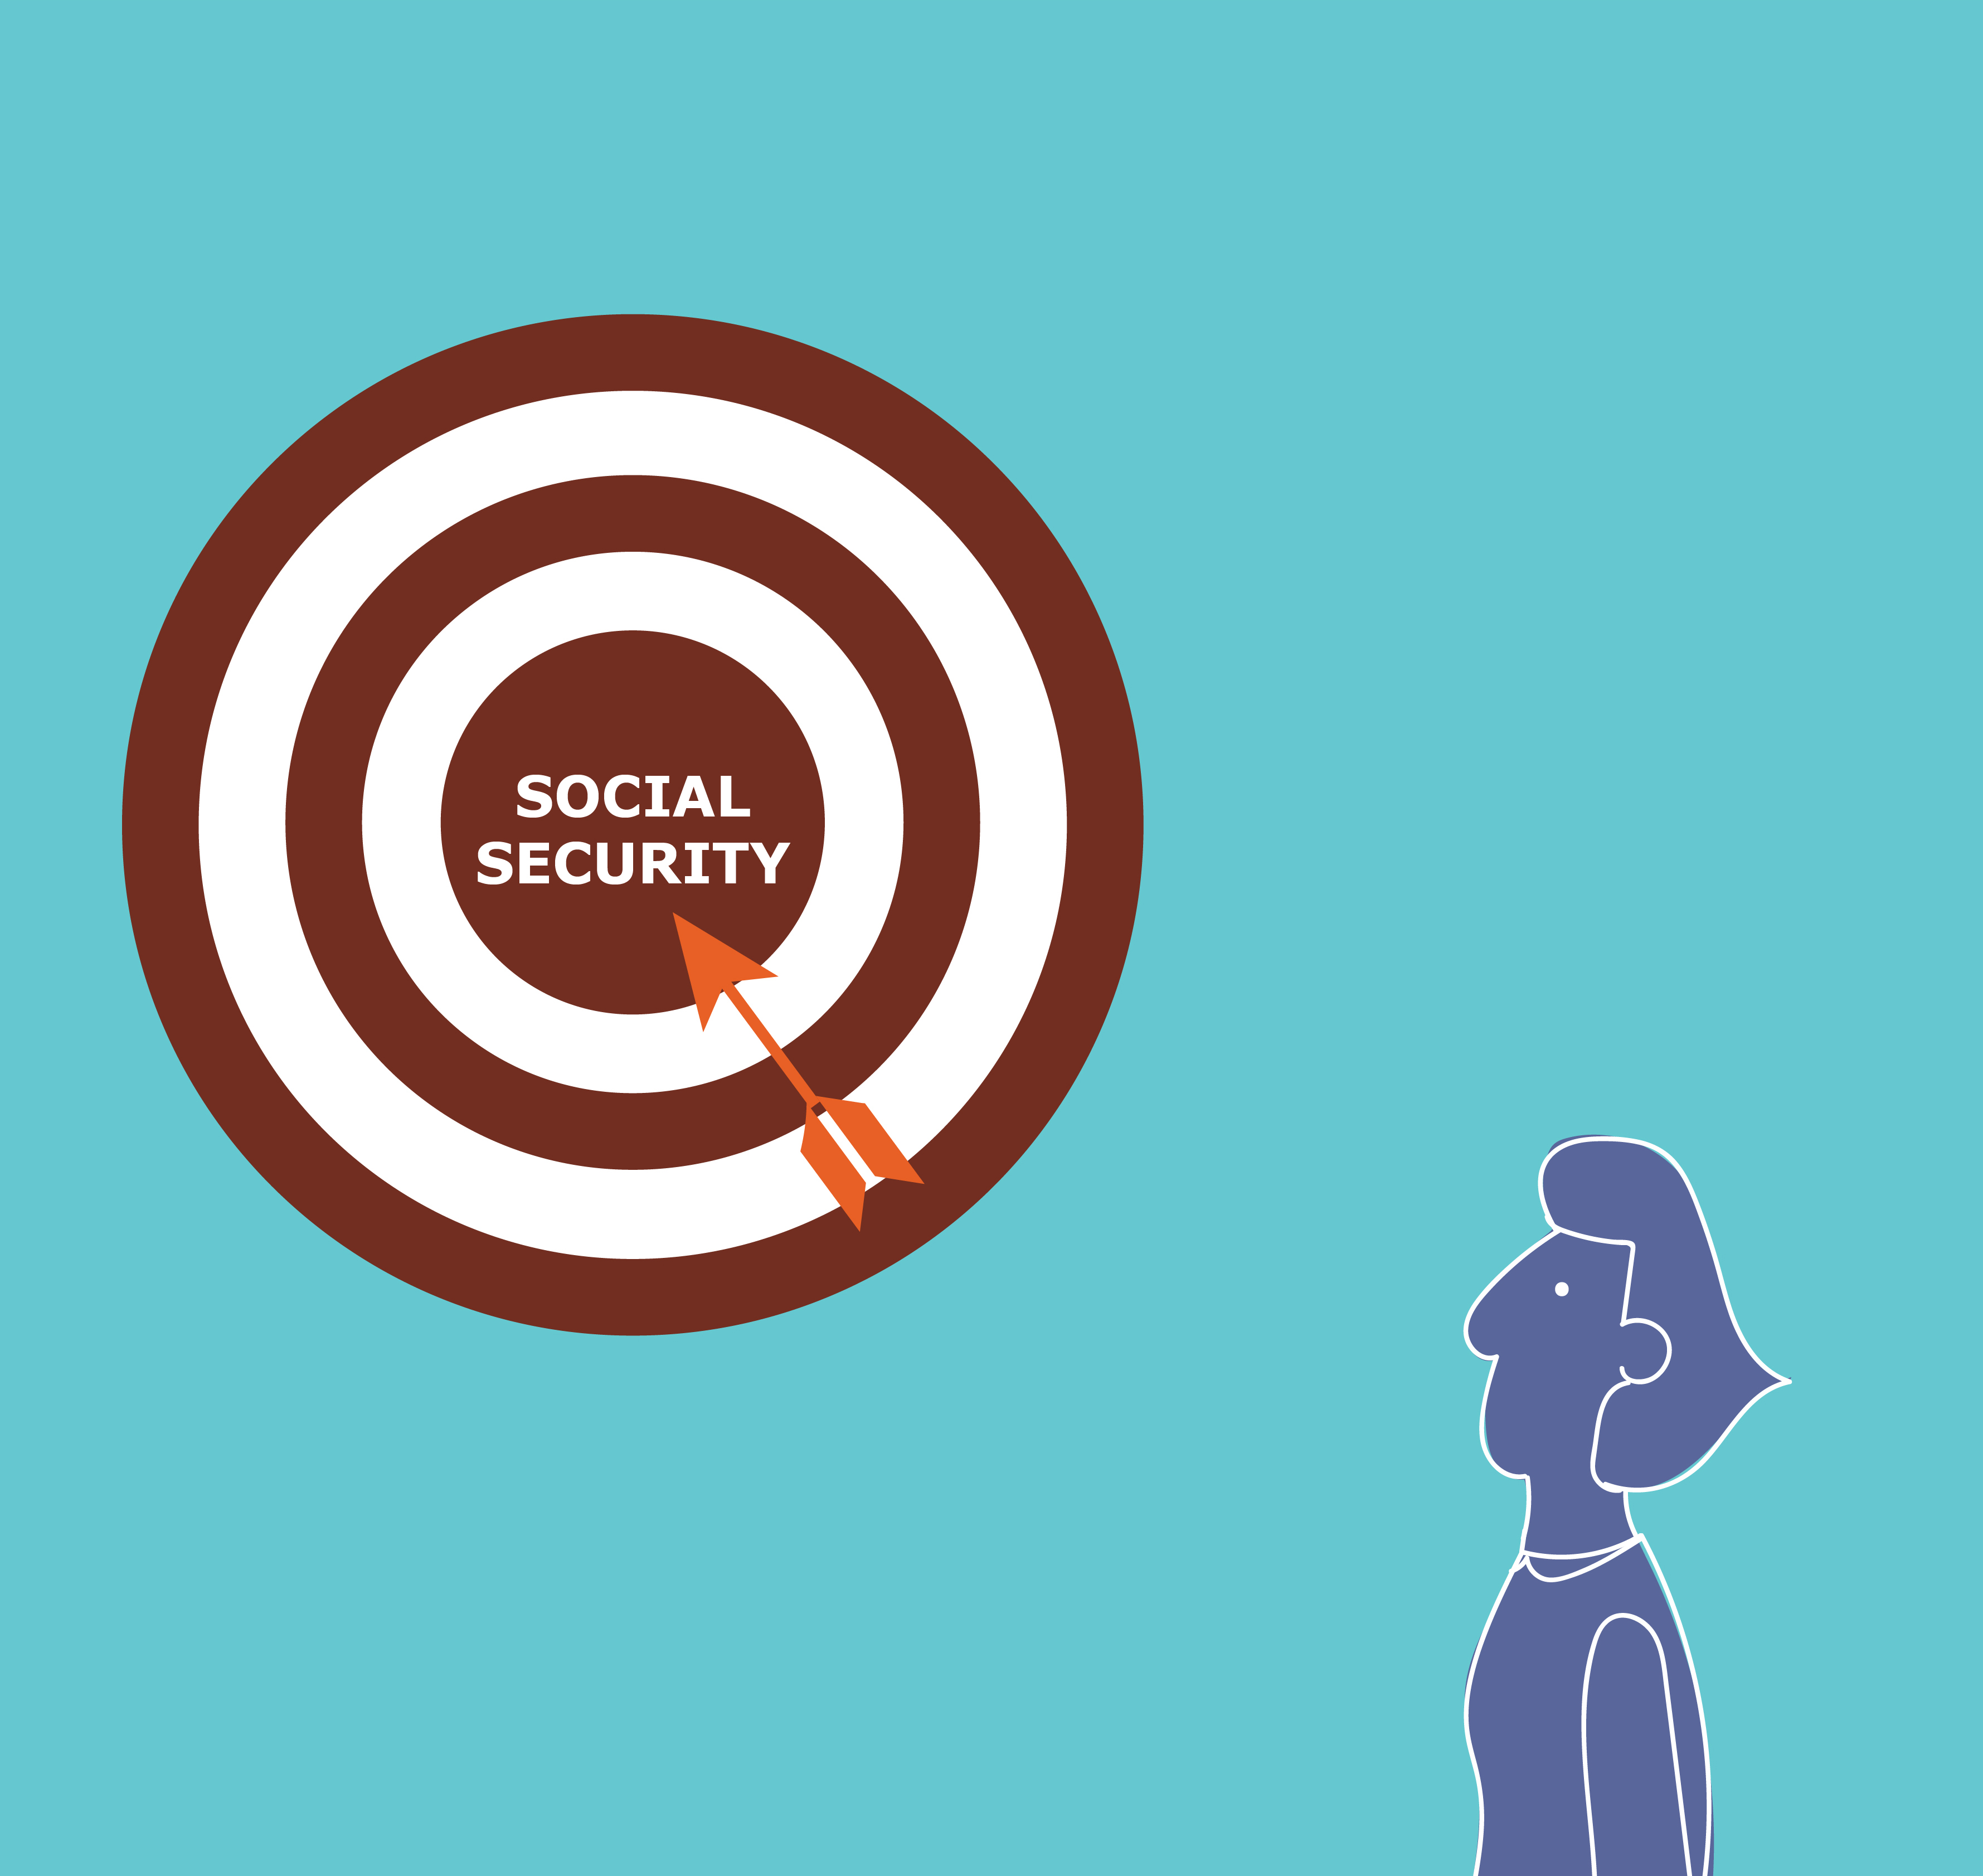
Social Security is your best source of retirement income.
It’s inflation proof.
It keeps coming as long as you live.
It also supports your spouse.
To find out how much you’ll get, log on: ssa.gov/myaccount
Notes:
Even if your spouse has never worked, they may qualify for benefits based on your Social Security benefit. Your spouse will receive these benefits while you are alive and after you die.
To create a My Social Security account you will need:
a valid email address,
your Social Security number,
a U.S. mailing address, and
to be at least 18 years of age.

Slide 7
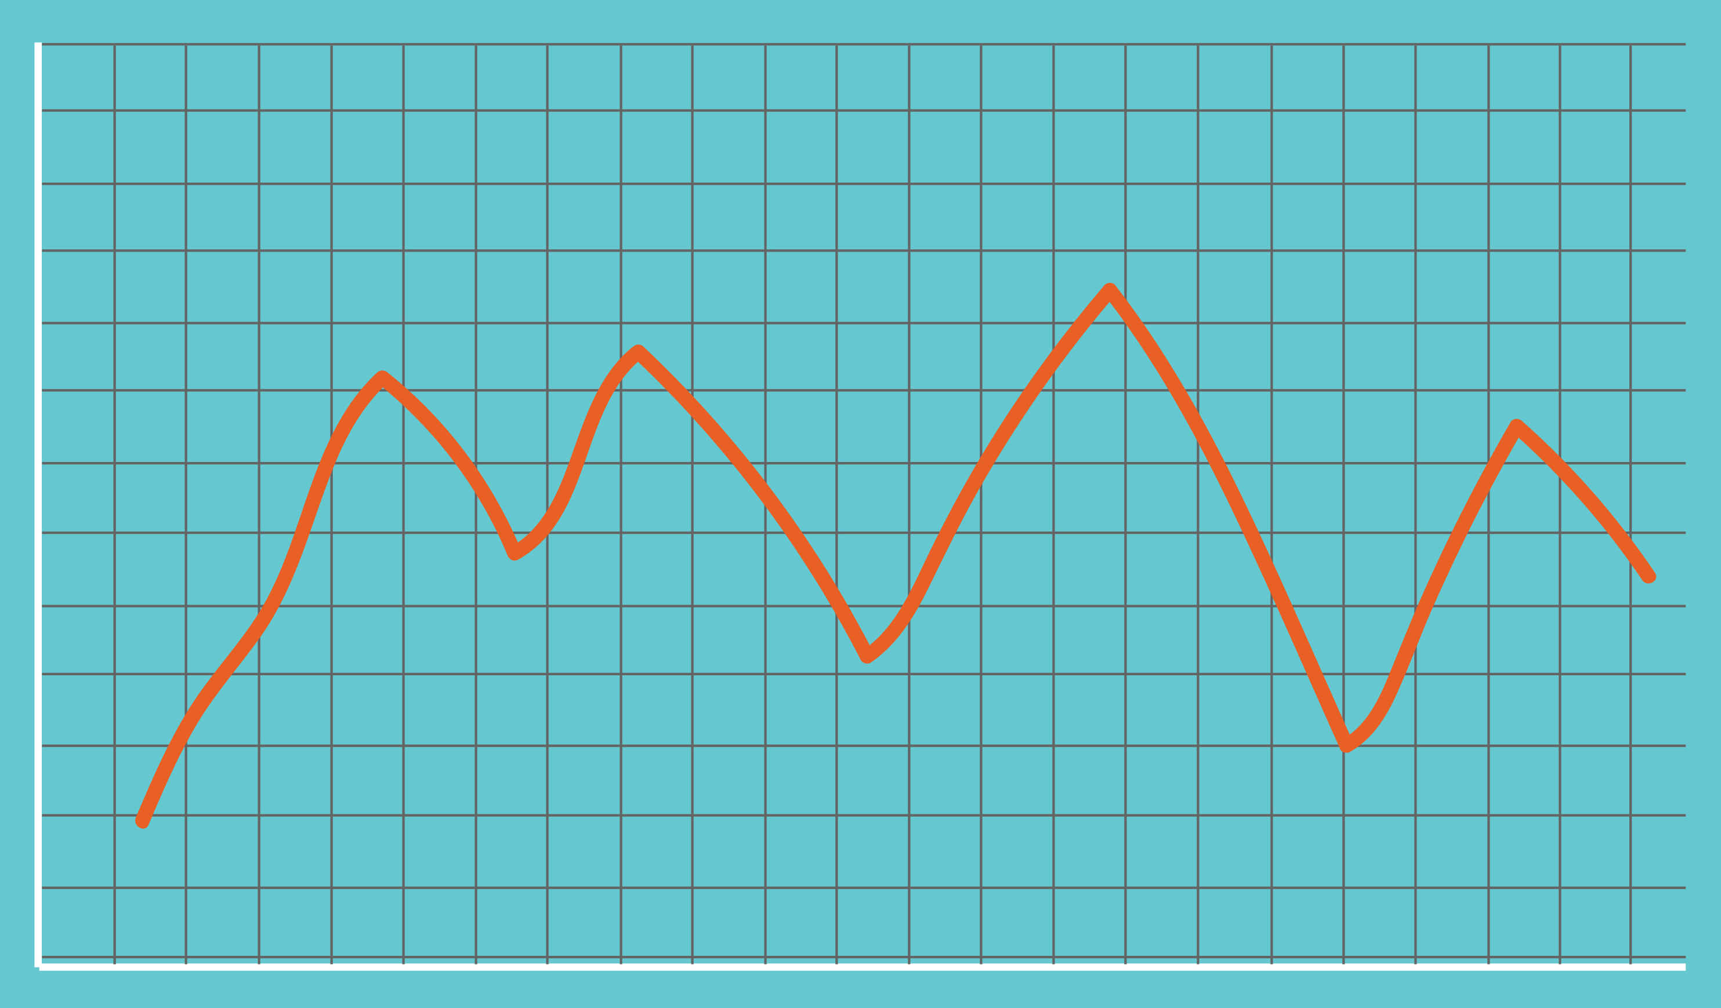
Other retirement income is less secure.
Pensions are not inflation-proof, and they are disappearing.
401(k)/IRA assets go down as well as up and may run out.
Notes:
Defined-benefit pensions are not inflation-proof, and fewer people have them.

Slide 8
If you live your life expectancy, Monthly Social Security benefits keep lifetime benefits about equal no matter when you claim.
The later you claim, the more $ you will get each month.
Early Claimers
Late Claimers
$
$
Lifetime Benefits
Years
x
=
=
Years
x
Notes:
Social Security is designed to give you the same lifetime benefits regardless of when you claim.
If you claim before your Full Retirement Age, you get a smaller monthly benefit for a longer period of time. If you claim past your full retirement age, you get a larger monthly benefit for a shorter period of time.
If you are likely to die young, claiming Social Security benefits early gives you more lifetime benefits. If you’re likely to live longer, delaying claiming Social Security makes all the more sense.

Slide 9
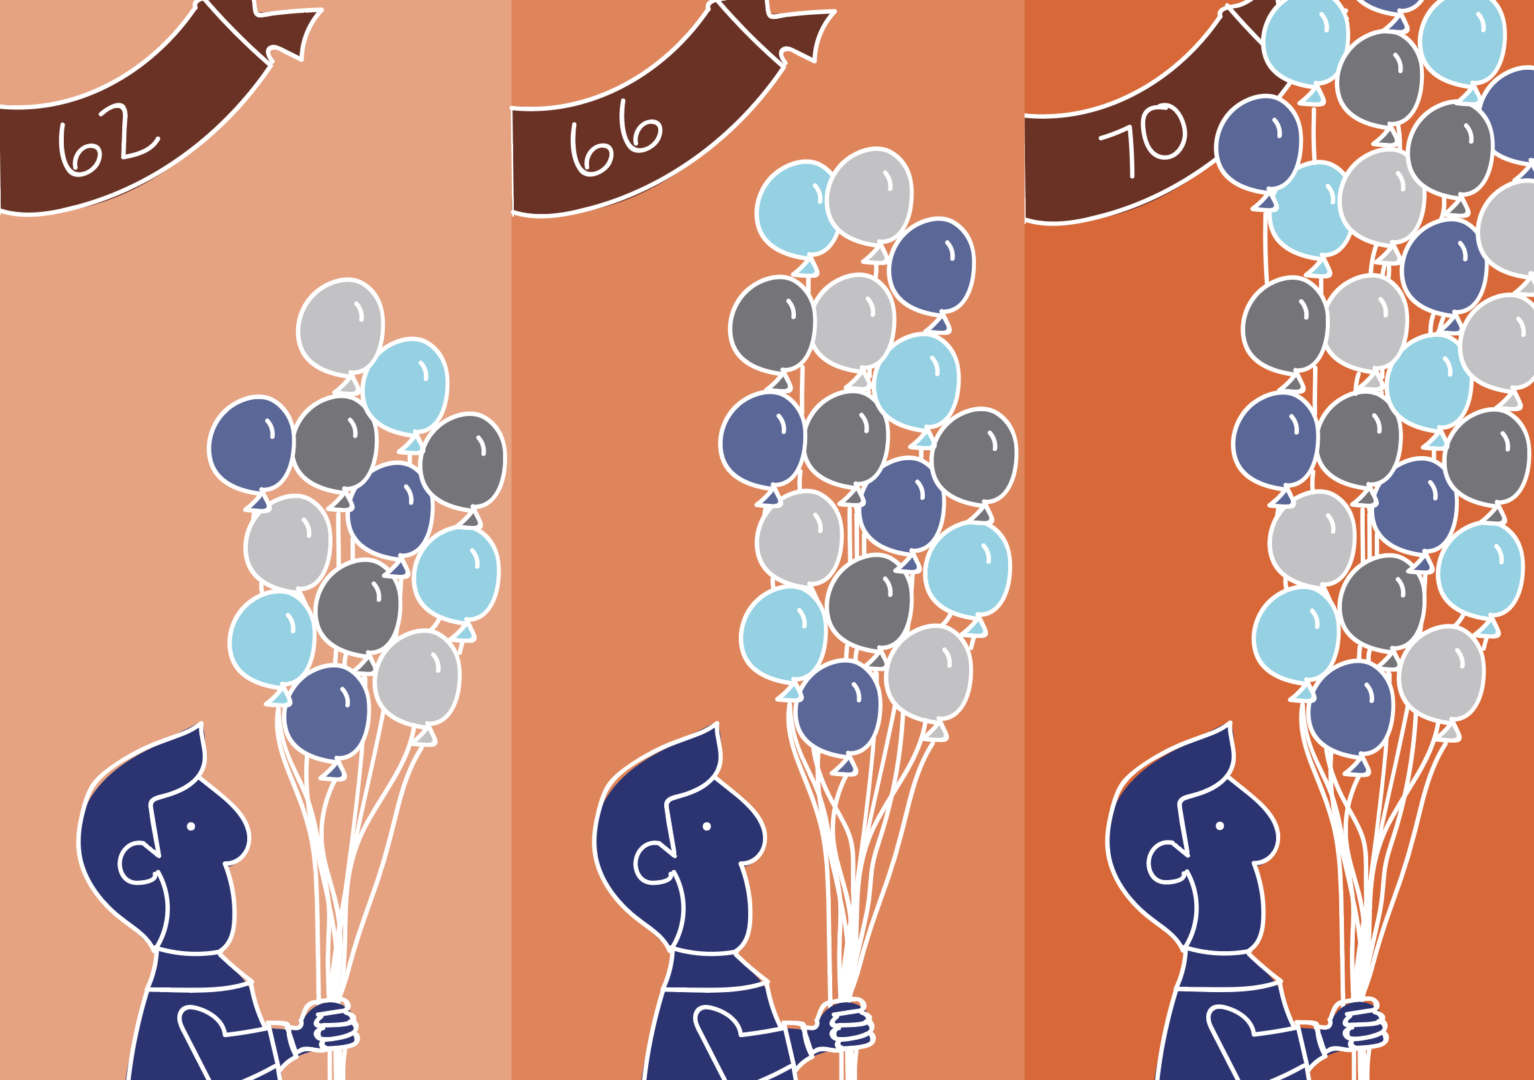
Delaying to 70 gets you 76 percent more.
When you claim determines your monthly benefit:
Your claim age | 62 | 66 | 70
Monthly benefit | $1,000 | $1,333 | $1,760
Note: Benefit amount in example is illustrative.
Notes:
Note the benefit amount in the example is illustrative, you may receive a lot less than $1,000 a month if you claim at age 62.

Slide 10
Delaying also means more for your spouse.
The survivor benefit is 60 percent higher if you claim at age 70 rather
than 62.
Notes:
A simple example: if you claim at age 62, when you die your spouse would receive a $1,000 monthly benefit. But if you waited to claim your Social Security benefit at age 70, your spouse could receive $1,600, unless her own worker benefit is higher.

Slide 11
Yes, you might get less over your lifetime if you claim later.
But even many unhealthy people still outlive the average.
And it’s costly to get stuck with low monthly benefits forever.
If you outlive your other assets, having a large Social Security Benefit will be all the more crucial.

Slide 12
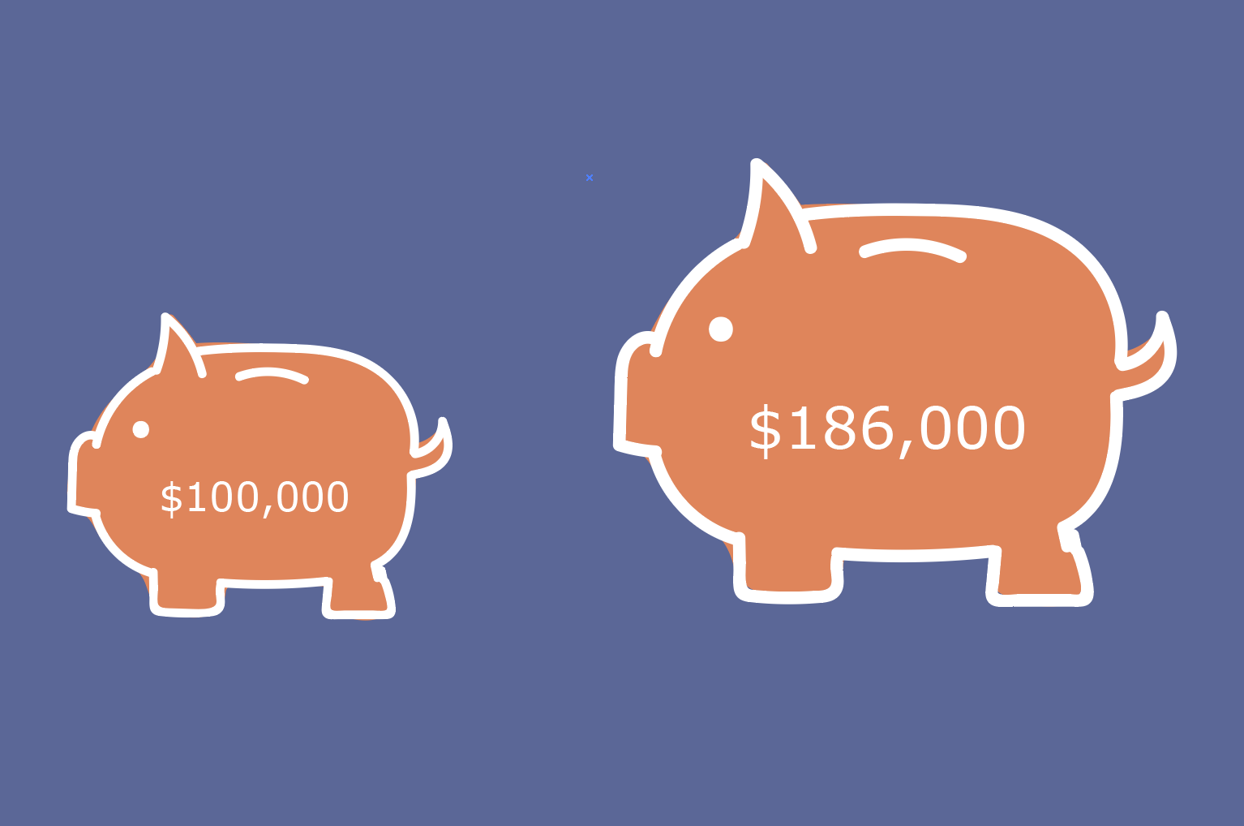
Working longer can help your 401(k)/IRA assets.
401(k) Assets Can Nearly Double Between Ages 62 and 70
Note: Assumes an inflation-adjusted return of 4.6 percent.
Notes:
This growth in 401(k) balance assumes that you keep contributing and that you do not spend any of your 401(k) savings.

Slide 13
And working longer doesn’t just help your finances.
It also can improve your:
physical health;
life expectancy; and
psychological well-being.

Slide 14
Most people today can work longer than in the past.
Jobs are less physically demanding.
People are healthier.
People are better educated.
Notes:
* In presentation, go over company-specific HR policies to help people work longer.

Slide 15
With increases in life expectancy, even working to 70 leaves a long retirement.
Years in Retirement to Keep Ratio of Retirement to Working Years Constant
Retirement years
Working years
Note: People are assumed to start work at age 20.
Source: U.S. Social Security Administration. 2018. Longevity Visualizer.

Slide 16
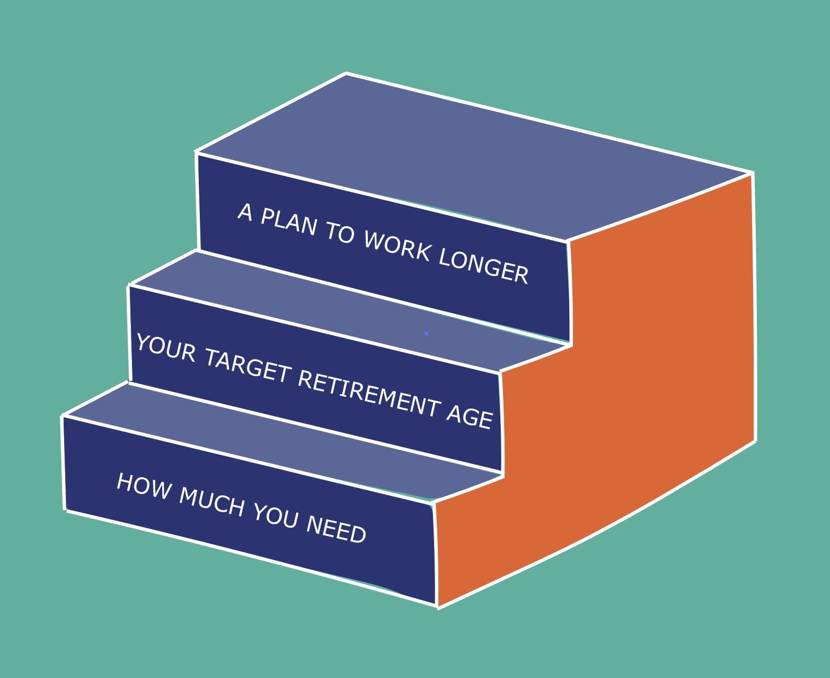
Next steps
Figure out how much you need.
Estimate your target retirement age.
Make a plan to work longer.
Learn new skills.
Be prepared to take on a new role at work.
Signal to your employer that you want to stick around.
Notes:
*Make last bullet relevant to company

