Slide 1
The Implications of Differential Trends in Mortality for Social Security Policy
John Bound, Arline Geronimus, Javier Rodriguez,
University of Michigan
Timothy Waidmann
Urban Institute

Slide 2
Background
Life expectancy in the U.S. has risen substantially since the Social Security Program was enacted into law.
Life expectancy at 25 rose from 69 to 80 between 1940 and 2010.
Evidence also suggests elderly morbidity has improved.
Under these circumstances, it would seem natural to raise the Social Security Retirement ages.
However there is also evidence that gains in life expectancy and morbidity have not been equally shared.
Researches have consistently found evidence that the gains have been concentrated amongst advantaged members of the population (e.g. Waldron, 2007).

Slide 3
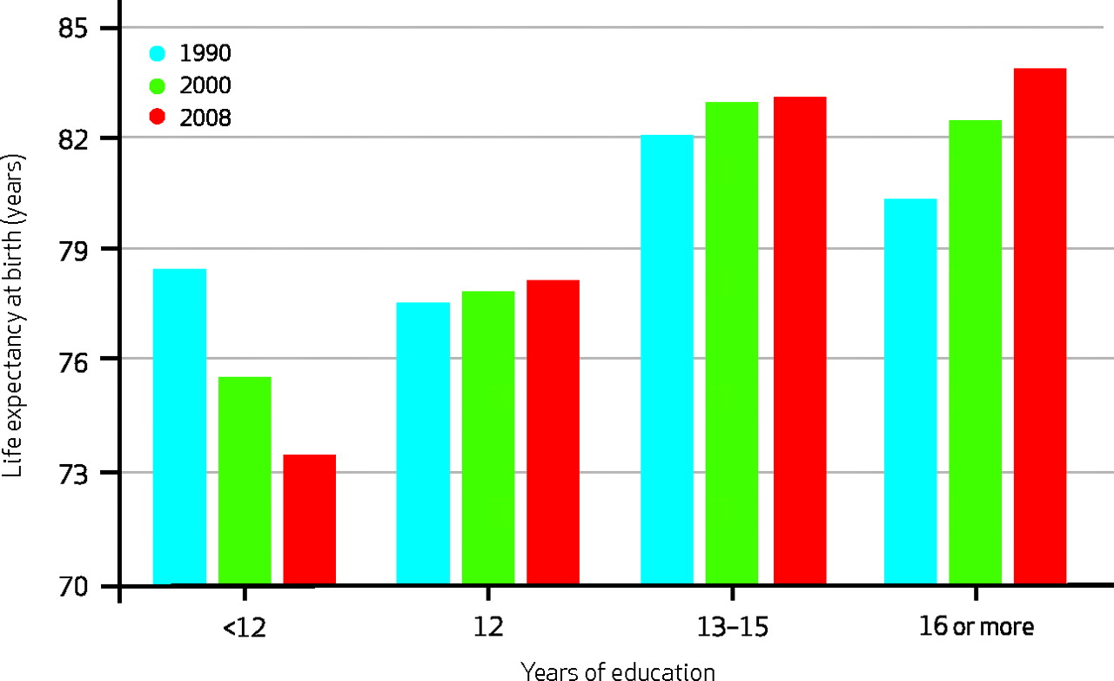
Life Expectancy At Birth, By Years Of Education At Age 25 For White Females, 1990–2008.
Olshansky S J et al. Health Aff 2012;31:1803-1813
©2012 by Project HOPE - The People-to-People Health Foundation, Inc.

Slide 4
Change in Life Expectancy at Age 25
 | Non-Hispanic White Women, LTHS | Non-Hispanic White Men, LTHS
1990 | 54.5 | 47.0
2008 | 49.2 | 43.6
Difference | -5.3 | -3.4
Source: Olshansky et al.

Slide 5
What is going on?
Short of a war or a major epidemic drops in life expectancy of 3 to 5 years in a developed country are virtually unprecedented.
Point of this project was to re-examine the evidence. Is Olshansky et al.’s finding robust.

Slide 6
Data
Deaths: National Vital Statistics System, Multiple Cause of Death files, 1990, 2000 & 2010
Population: IPUMS US Census data
Decennial census, 1940-2000
American Community Survey, 2001-2010
This is same data used by Olshansky et al.

Slide 7
Can we replicate basic finding?
Olshansky et al. included all age groups, making adjustments to take account of known problems with age specific mortality rates amongst the elderly.
We will calculate survival curves for men and women between the age of 25 and 85.
If life expectancy dropped for those with less than a high school education, survival curves should shift in.

Slide 8
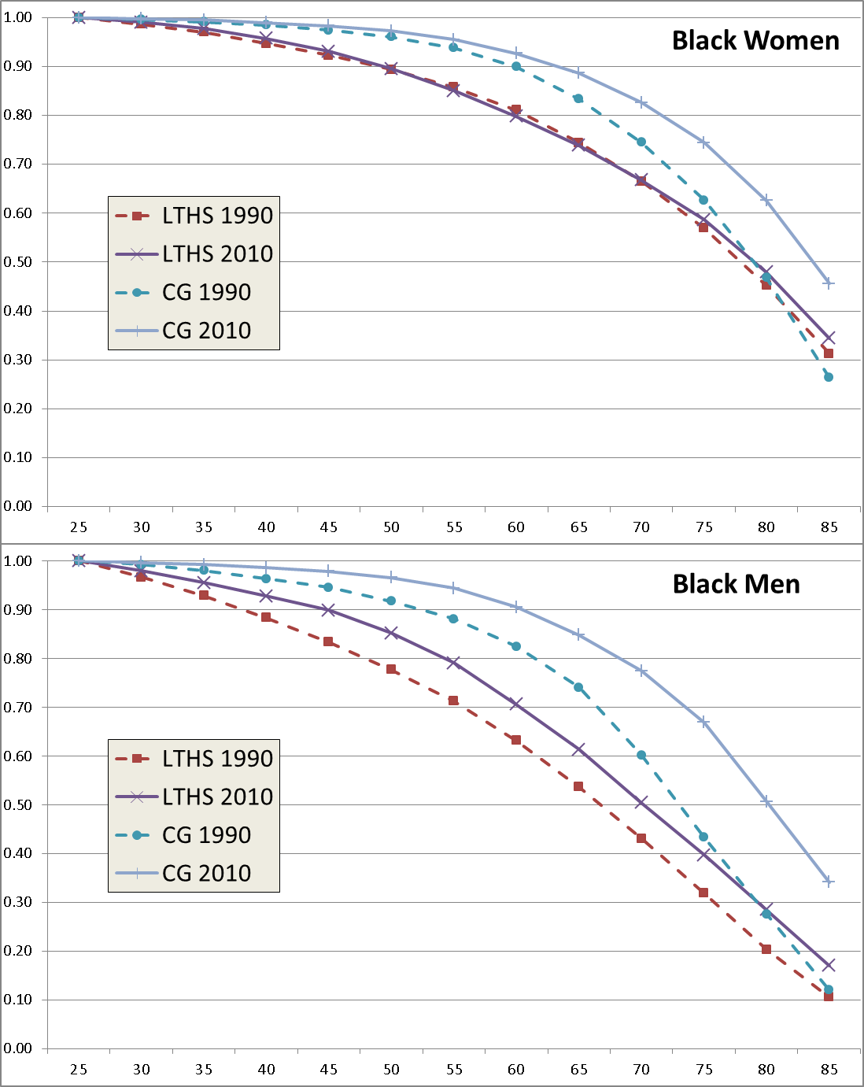
Survival after age 25, by level of education
Source: Authors’ calculations from NVSS & Census data

Slide 9
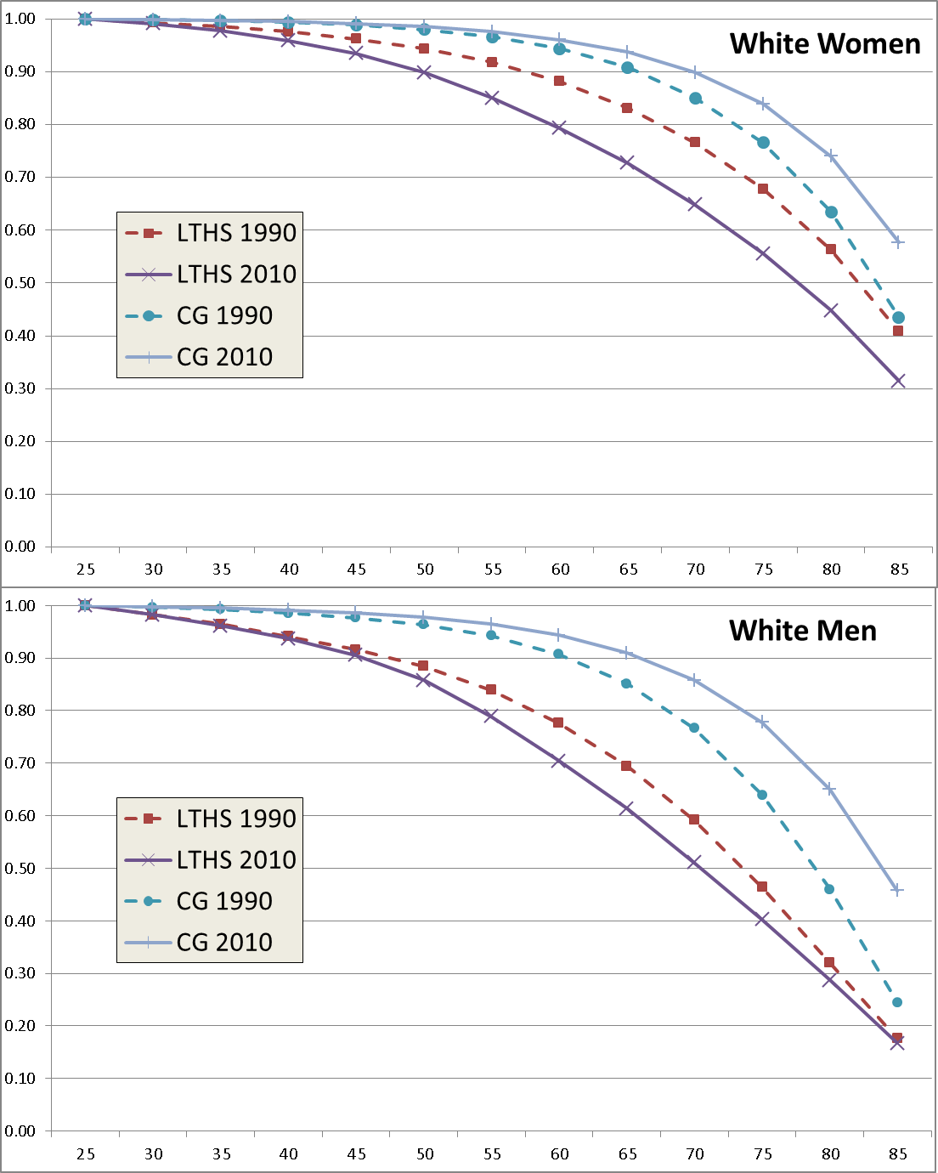
Survival after age 25, by level of education
Source: Authors’ calculations from NVSS & Census data

Slide 10
Using Educational Attainment Levels we replicated Olshansky et al.
But, the fraction of the US population graduating from high school rose dramatically of the 20th century. As a result, high school drop outs are becoming a more and more select group.

Slide 11
Change in High School Graduation Rates, by Birth Cohort
Source: Authors’ calculations using IPUMS Census data

Slide 12
What if we use educational rank
Given the dramatic rise in the fraction of the population finishing high school, stratifying by rank in the educational distribution would seem to be a plausible alternative to using education levels.
We stratified by gender and race, distinguishing between those in the bottom 25 percent and top 75 percent of their gender and race specific cohorts.

Slide 13
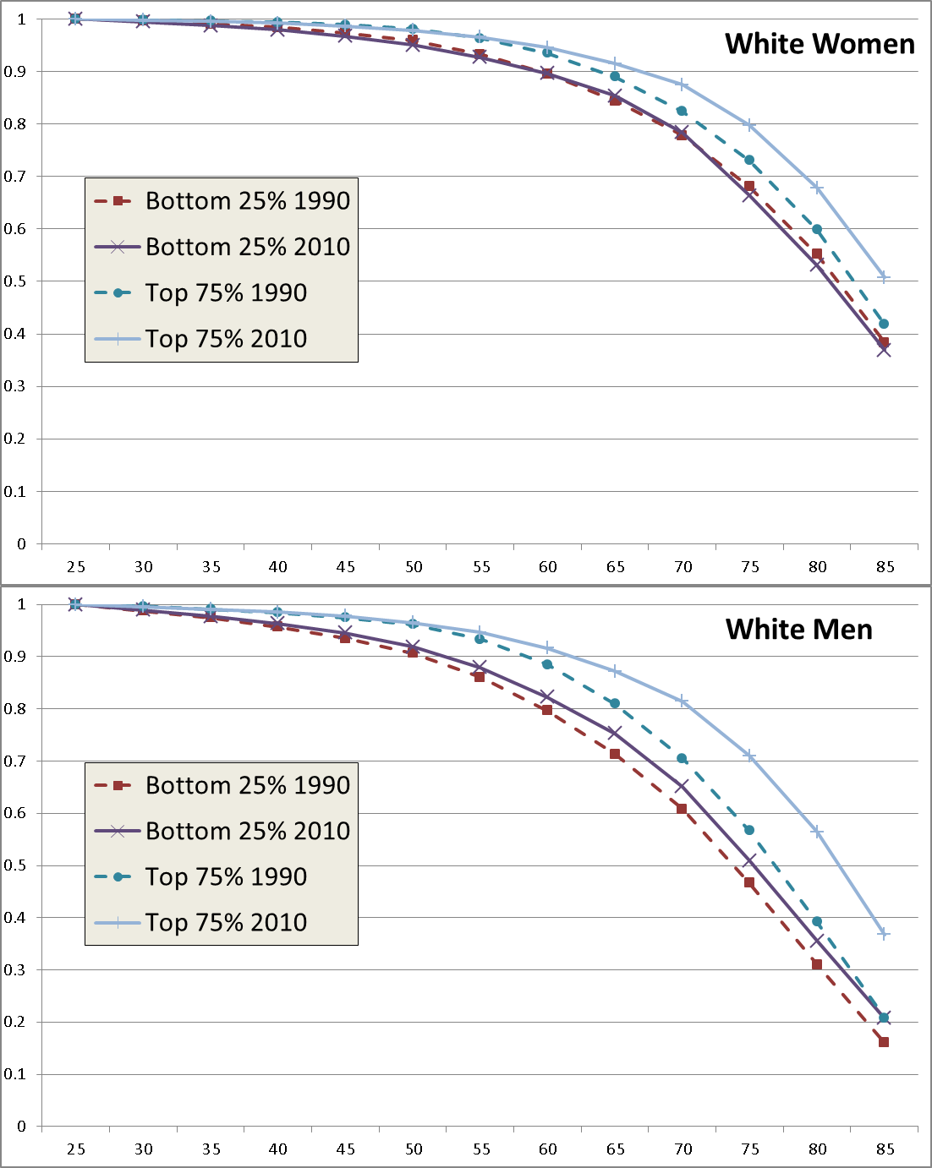
Survival by educational rank
Source: Authors’ calculations from NVSS & Census data

Slide 14
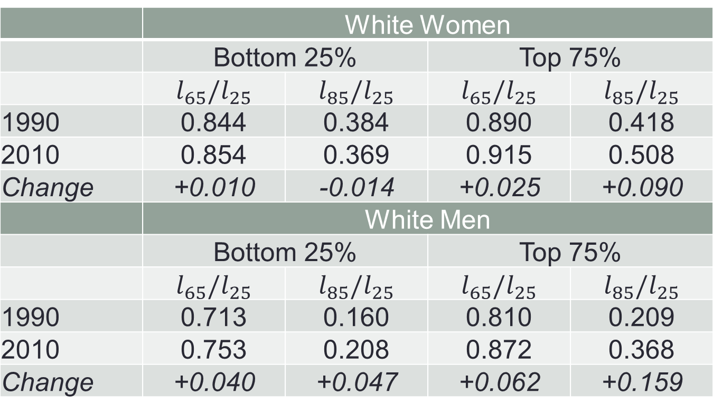
Change in Survival Probabilities to 65 and 85, by educational rank
 | White Women
 | Bottom 25% |  | Top 75%
 | $$l_{65}/l_{25}$$ | $$l_{85}/l_{25}$$ | $$l_{65}/l_{25}$$ | $$l_{85}/l_{25}$$
1990 | 0.844 | 0.384 | 0.890 | 0.418
2010 | 0.854 | 0.369 | 0.915 | 0.508
Change | +0.010 | -0.014 | +0.025 | +0.090
 | White Men
 | Bottom 25% |  | Top 75%
 | $$l_{65}/l_{25}$$ | $$l_{85}/l_{25}$$ | $$l_{65}/l_{25}$$ | $$l_{85}/l_{25}$$
1990 | 0.713 | 0.160 | 0.810 | 0.209
2010 | 0.753 | 0.208 | 0.872 | 0.368
Change | +0.040 | +0.047 | +0.062 | +0.159

Slide 15
Results
For white women, little change amongst the bottom 25 percent. Significant gains for the top 75 percent.
For white men, gains for both, but larger gains for those in the top 75 percent.
When stratifying by quartile, one finds evidence of increased dispersion of life expectancy, but no evidence of any drop for the bottom quartile.

Slide 16
Problems with Education Data in Vital Statistics
Preceding statistics require matching education levels between census surveys and death certificates. This is not straightforward
Coding changes over time in both sources, never identical
In 2010 death certificates, two alternative coding schemes used
Many death records missing, sometimes for entire states
Need imputations to get complete counts from both sources
Even when not missing, evidence of misreporting of education by next of kin to funeral director (Rostron et al., 2010)
National Longitudinal Morality Study: 28% of death certificate reports do not match earlier CPS self-reports in linked data.
20% of LTHS reported as HS Graduates (or more) on death certificate
6% of HS graduates (or more) reported as LTHS
More mis-reporting for non-whites

Slide 17
Alternative Approach
Look at over all survival curves.
If a segment of the population is dying at younger ages, while others are living longer, one should see two closely related patterns.
1. There should be a spreading out of the distribution of the age at death, with more dying at young ages at the same time that more are dying at older ages.
2. The probability a person reaches the age of 45 or 65 should drop, while the probability they reach 75 or 85 should rise.
No need to use data on education for this.

Slide 18
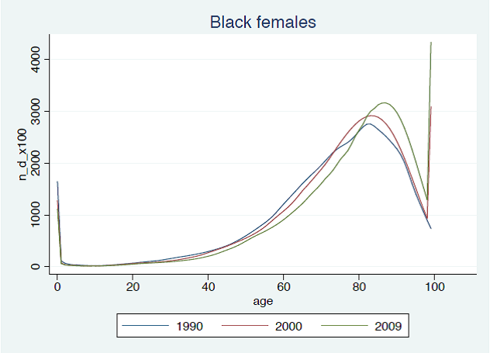
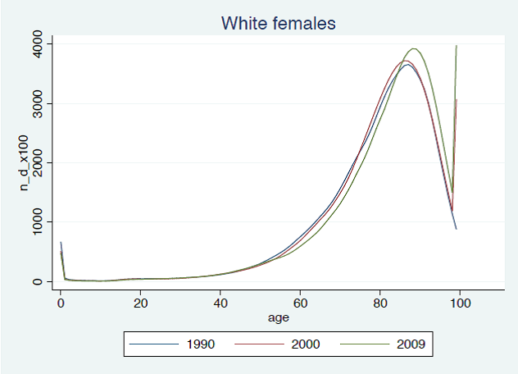
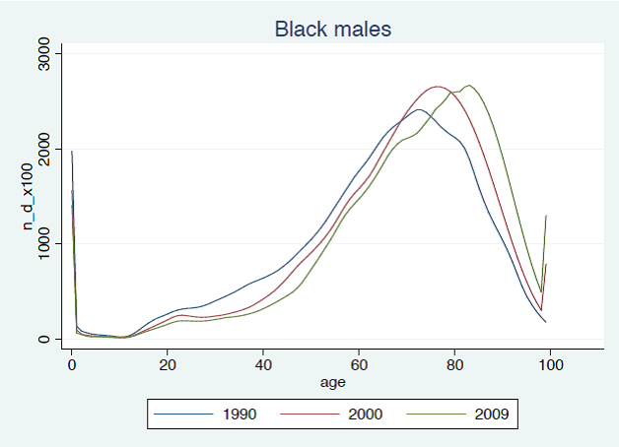
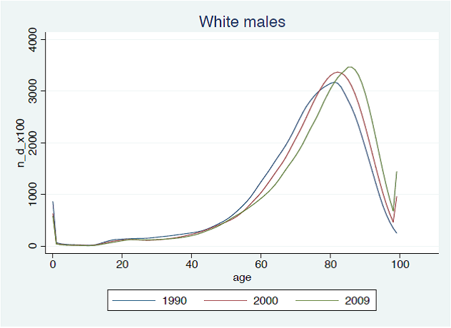
Distribution of Life Table Age at Death
Source: Published NCHS Life Tables

Slide 19
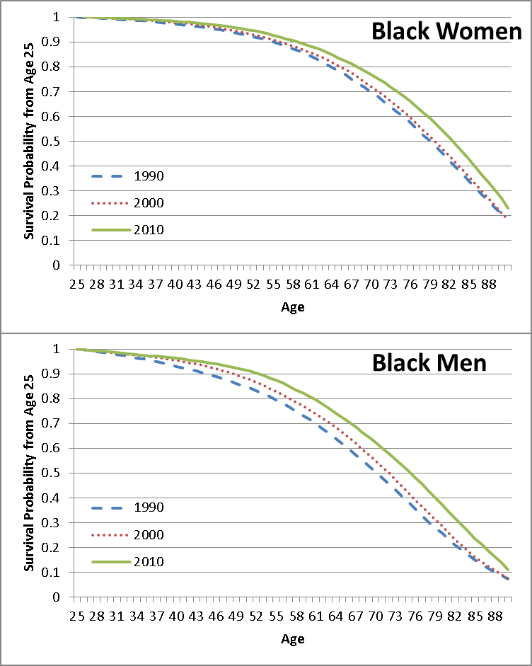
(Period) Life Table Survival Curves
Source: Authors’ calculations from NVSS & Census data

Slide 20
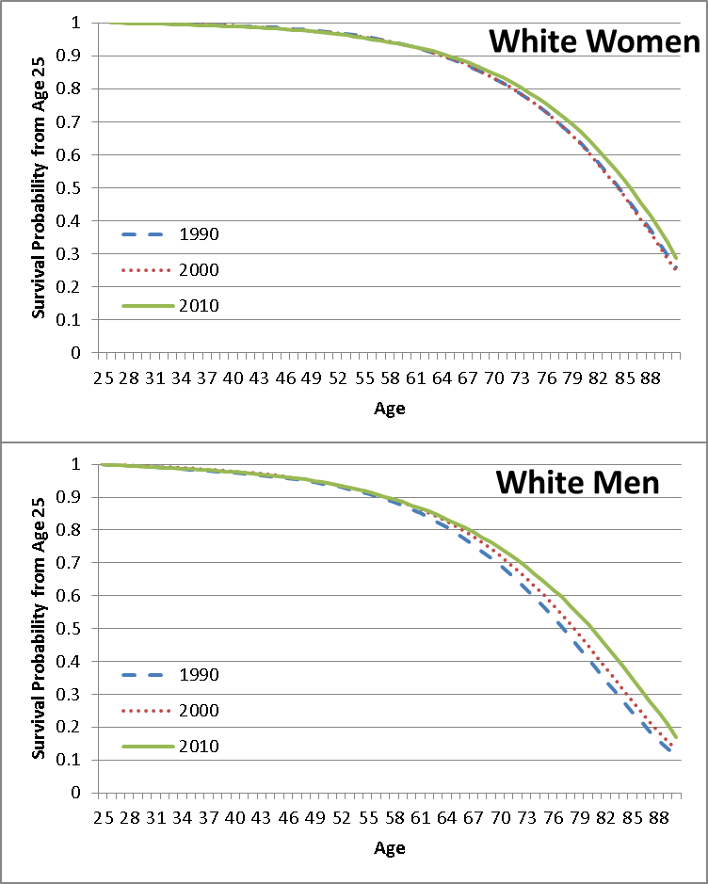
(Period) Life Table Survival Curves
Source: Authors’ calculations from NVSS & Census data

Slide 21
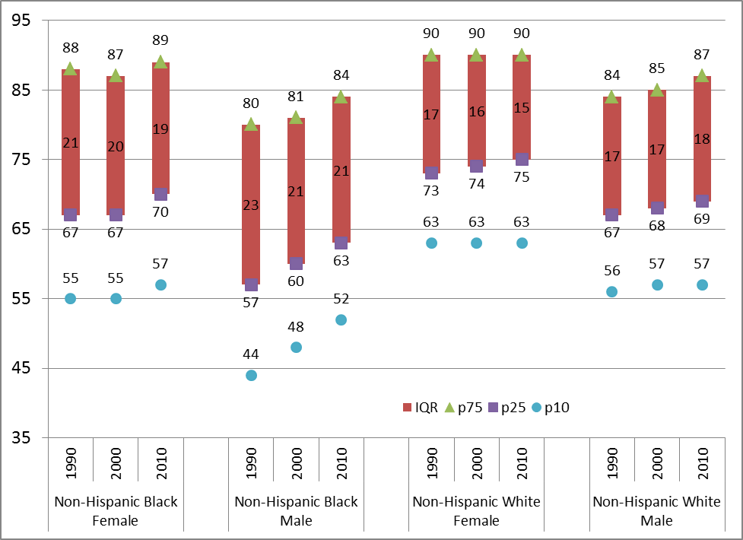
Dispersion of life expectancy (post 25)
Source: Authors’ calculations from NVSS & Census data

Slide 22
Results
Distribution of age at death appears to be shifting out for black and white men and women.
Survival curves shift out for black and white men and women.

Slide 23
An Alternative Way to Look at Data
Using the same data, we can calculate the probability a 25 year old makes it to 65, 75 or 85.

Slide 24
Survival to age 65,75 and 85

Slide 25
Results
For whites, there is not much change in the chances a 25 year old reaches 65. Roughly 11% of white women and 20% of white men who reach it to 25 do not reach it to 65.
The chances Black men and women make it to 65 is substantially less than it is for their white counterparts, but here we see improvements.
Improvements at 75 are uniformly larger than improvements at 65. For whites improvements at 85 are larger still.

Slide 26
Summary
If we use levels of educational attainment we replicate Olshansky et al.’s findings. Survival prospects worsened for white high school drop outs.
If we stratify education by rank in the distribution, contrasting the bottom quartile to the top three quartiles, we find evidence of an increased dispersion of survival prospects, but no evidence that survival prospects for the bottom quartile of the education distribution is getting worse.
Examining survival curves for White and Black men and women, we find little evidence of any increased dispersion of survival prospects.
2 and 3 together suggest a compression of mortality within but not between education groups.

