Slide 1
The Benefits Trajectory and Labor Market Experience of Older Workers Who Were Denied SSDI on the Basis of Work Capacity
Jody Schimmel Hyde
April Yanyuan Wu
SSA’s Retirement Research Consortium
19th Annual Meeting
August 3-4, 2017

Slide 2
Research Questions
Applicants for SSDI may be denied benefits because they are deemed able to work
The job they held before disability onset
Another job in the U.S. economy
Among older SSDI applicants denied on the basis of work capacity:
What share return to work?
To what type of work do they return?
2

Slide 3
Significance of the Question
A large share of SSDI applicants are over age 50
Vocational factors (age, education, and work experience) primarily affect older applicants
Denials based on work capacity assume that applicants can return to work, but do they?
If they don’t, are there employment services or supports from which denied applicants could benefit?
Should the consideration of vocational factors be re-evaluated?
3

Slide 4
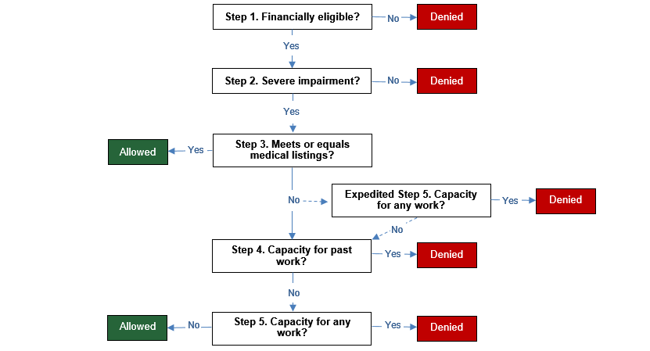
SSA’s Sequential Disability Determination Process
Denied for medical reasons
Denied for work-capacity reasons
Source: Wixon and Strand (2013), Strand and Trenkamp (2016).
4

Slide 5
Analysis Overview
The Health and Retirement Study (HRS) was used to identify SSDI applicants over age 50
HRS linked to:
SSA 831 files
Cross-Year Benefits file
Summary Earnings file
Sample of SSDI applicants may not be nationally representative
5

Slide 6
Applicants Grouped by Initial Decision and Reason
Decision category | Allowed | Denied
Total | 421 | 384
Medical reasons | 133 (31.6%) | 125 (32.6%)
Work-capacity reasons | 288 (68.4%) | 259 (67.4%)
Able to perform past job (Step 4) | -- | 184 (47.9%)
Able to perform other job (Step 5) | -- | 75 (19.5%)
Source: Authors’ calculations using HRS linked to SSA’s 831 file; categorization of initial SSDI outcomes based on the scheme outlined in Wixon and Strand (2013).
6

Slide 7
A Few Differences in Pre-Application Characteristics Based on Denial Reason
Relative to other denied applicants:
Applicants denied at Step 4 (past job):
Are more likely to be unmarried
Are more likely to be female
Are less likely to have post-secondary education
Have longer job tenure
Applicants denied at Step 5 (other job):
Are younger, on average
Are more likely to have post-secondary education
Earn a higher hourly wage
Have more years of earnings between ages 22 and 50
Have higher total household income
7

Slide 8
What Happens After Initial Denial?
The 831 data allows us to consider the initial determination, but many appeal the initial decision
How many appealed the initial decision?
Among those who appealed, were ultimately awarded SSDI?
Those who do not appeal or unsuccessfully appeal may reapply as their condition declines
How many reapplied for benefits later, and were they awarded benefits?
The likelihood of returning to work after initial denial likely relates to appeal or reapplication
8

Slide 9
Most Older Applicants Initially Denied for Work Capacity Ultimately Receive SSDI
63.6%
62.0%
31.2%
Source: Authors’ calculations using the HRS linked to SSA’s 831 and Cross-Year Benefits File.
Note: The percentages in the “other job” category have been rounded to avoid revealing small cells.
9

Slide 10
Among Those Who Do Not Receive SSDI, Claiming OASI Before FRA Is Common
One-third of work-capacity denials and two-thirds of medical denials do not receive SSDI before the full retirement age (FRA)
Old-Age and Survivors Insurance (OASI) benefits can be claimed as early as age 62; the average applicant in our sample was about 58 at application
Most older denied applicants claim OASI before the FRA
Not everyone in our sample reached age 62 and/or the FRA by the end of the observation period
10

Slide 11
Few Denied Applicants Return to Work, with Little Difference by Denial Reason
Source: Authors’ calculations using the HRS linked to SSA’s file and the Summary Earnings File.
Note: The share with positive earnings assumes that people without an annual record in the Summary Earnings File did not have taxable income during the calendar year.
11

Slide 12
Denied Applicants Who Return to Work Have Lower Average Earnings
Source: Authors’ calculations using the HRS linked to SSA’s file and the Summary Earnings File.
Note: Earnings have been inflation-adjusted to 2012 dollars.
12

Slide 13
Some Questions Answered, but Many Remain
Very few older SSDI applicants who have been denied return to work, and post-denial average earnings are lower than average earnings pre-application
To what types of jobs do denied applicants return?
What is different about those who return to work?
Services and supports could possibly assist with retraining to prolong labor force participation
In what types of occupations do denied applicants work before seeking SSDI?
We are exploring this question using our data linked to the Department of Labor’s O*NET data
13

Slide 14
Contact Information
Jody Schimmel Hyde
Center for Studying Disability Policy
Mathematica Policy Research
1100 1st Street, NE, 12th Floor
Washington, DC 20002
(202) 554-7550
jschimmel@mathematica-mpr.com
http://www.DisabilityPolicyResearch.org
14

