Slide 1
An Examination of Parents with an Unemployed Child
Kathryn Anne Edwards and Jeffrey B. Wenger
RAND Corporation
August 3, 2017

Slide 2
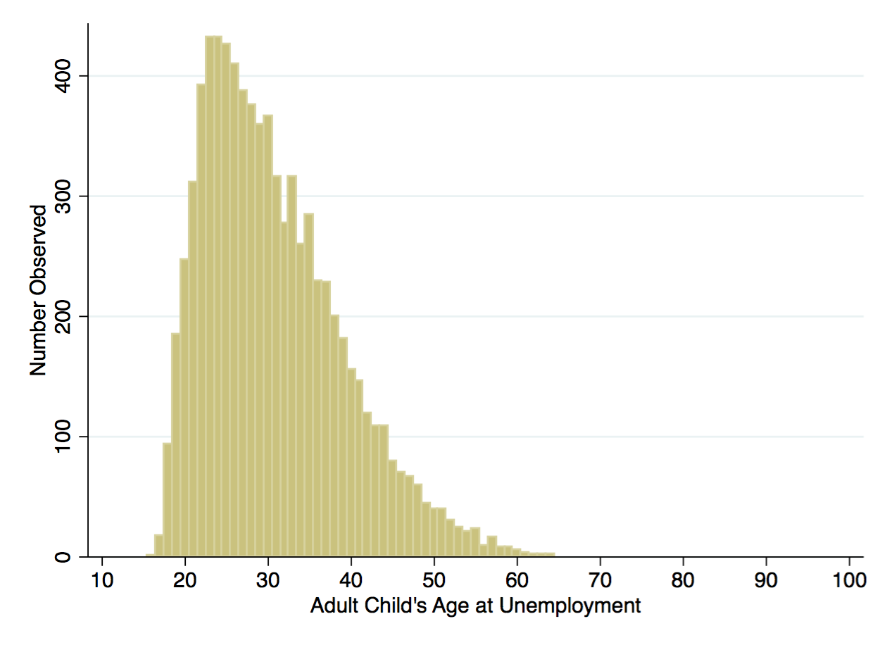
Figure 1: Age of Unemployed Heads/Spouses of Households, PSID, 1985-2013

Slide 3
Figure 2: Age of Mothers of Unemployed Heads/Spouses, PSID, 1985-2013

Slide 4
Prior Research
Families provide financial support to their unemployed members
Intra-family, inter-household cash assistance
1970-2012 Panel Study of Income Dynamics: Receipt from any family member (Edwards, 2016)
2008-2010 American Life Panel
Giving and receiving among family members (80% parents) (Cox and Way, 2011)
1992-2008 Health and Retirement Study
Giving from parents to children (McGarry 2016)

Slide 5
Question
To what extent do parents adjust their behavior when their child is unemployed?

Slide 6
Question
To what extent do parents adjust their behavior when their child is unemployed?
Budget Constraint:
0 = Income_{E} - Consumption_{E} - Savings_{E}

Slide 7
Question
To what extent do parents adjust their behavior when their child is unemployed?
Budget Constraint:
0 = Income_{E} - Consumption_{E} - Savings_{E}
0 = Income_{U} - Consumption_{U} - Savings_{U} - Transfer_{U}

Slide 8
Question
To what extent do parents adjust their behavior when their child is unemployed?
Budget Constraint:
0 = Income_{E} - Consumption_{E} - Savings_{E}
0 = Income_{U} - Consumption_{U} - Savings_{U} - Transfer_{U} Transfer_{U} = ∆Income - ∆Consumption - ∆Savings

Slide 9
Question
To what extent do parents adjust their behavior when their child is unemployed?
Budget Constraint:
0 = Income_{E} - Consumption_{E} - Savings_{E}
0 = Income_{U} - Consumption_{U} - Savings_{U} - Transfer_{U} Transfer_{U} = ∆Income - ∆Consumption - ∆Savings
Goal: (empirically) identify ∆Income, ∆Consumption,
∆Savings due to child’s unemployment

Slide 10
This paper
Concurrently observed mothers and adult children in the Panel Study of Income Dynamics
Three age groups of mothers:
< 62 years old
62-70 years old
70+ years old
Child unemployment spells that are not associated with school exit or (loss of head) co-residence

Slide 11
Model
Regress parent outcomes (Y_{pt} ) on a child’s unemployment spell (UKid_{pt} ), controlling for changing parent observables (X_{pt} ) and unchanging parental characteristics (θ_{p} ):
Y_{pt} = X_{p}^{t}_{t} β + γUKid_{pt} + θ_{p} + ε_{pt}
Causally identified to the extent that a child’s unemployment is random, given parent fixed effects.

Slide 12
Results
Transfers
(HH) Annual total of reported cash sent to a child
Increase in transfers
Sample Average: $270, Coefficient: $64
Significant for all age groups

Slide 13
Results
Income
(Ind) Labor Supply - Hours per Week
(Ind) Labor Supply - Weeks per Year
(HH) Social Security Receipt
Increase in annual weeks worked
Mothers < 62 years old
Larger if conditioned on prior labor force attachment
Conditional Sample Average: 32.0 weeks, Coefficient: .681
Increase in Social Security receipt
Mothers 65-70 years old and partnered
Some evidence larger effect for mothers at or above full retirement age
Conditional Sample Average: 87.3, Coefficient: .027

Slide 14
Results
Consumption
(HH) Annual food expenditures
Decrease in food consumption
Sample Average: $10955, Coefficient: -$224
Significant for all age groups; larger drop for older mothers

Slide 15
Results
Savings (1999-2013)
(Ind) Percent of income contributed to pension
(Ind) Any contribution to pension
(HH) Asset values (farm/business income, cash, real estate, other assets, stock, vehicles,)
Decrease in percent of income contributed to pension
Mothers <62 years old
Conditional Sample Average: .713, Coefficient: -.145
Increase in any (new) contribution
Mothers 62-70 years old
Conditional Sample Average: 3.4%, Coefficient: .019
Decrease in vehicle value
Varies with the adult child’s situation and relative education
Conditional Sample Average: $20500, Coefficient: -$1246

Slide 16
Research Considerations
The observed change in income, consumption, and savings in the year of the unemployment spell was larger than observed cash transfer.
Cash transfers are a small share of total assistance
Parents’ behavioral adjustments occur not only to finance any assistance, but as a result of changes in expectation or perceived risk.

Slide 17
Policy Considerations
This and other research points to evidence of parental provision of a safety net
Potentially increasing over time
Concurrent with dramatic changes to the safety net geared towards working-age population
Erosion of UI take-up
Welfare reform
Expansion of Medicaid and Food Stamps (SNAP)

