Slide 1
Ensuring our Future: Proposals for Funding the Social Security System
Melissa Kahn, Esq. Managing Director, SSGA
Retirement Research Consortium August 4, 2017
DC-4042

Slide 2
Who Loses? Possible Effects of Each Solution by Demographic
↓ Cost of Living Adjustment
Older beneficiaries
Highly-educated beneficiaries
High-income beneficiaries
Widow(er)s
Retired disabled population
Early retirees
Low-income beneficiaries
Minorities
↑ Full Retirement Age
Low-income beneficiaries
High income beneficiaries
Self-employed beneficiaries
High-income beneficiaries
$127,000+
6% of the population
↑ Payroll Taxes
↑ Tax Cap
DC-4042

Slide 3
High Income Earners have a Higher Share of the Vote Despite Being a Smaller Share of the Population
Income < $50,000
Population that Voted
Contribution to Overall Vote
25% of the vote
36% of population
31% of the vote
28% of population
Source: Census.gov
DC-4042

Slide 4
Voting Behaviors on Possible Outcomes — Age & Ideology
“The exhaustion of the SS Trust fund in 2034 will empower both the youth vote and middle aged America to try and preserve the benefits that they believe they are entitled to”
— Gallup
Population that Voted
Contribution to Overall Vote
Largest Vote Contributors:
25–44 year olds — 29%
45–64 year olds — 37%
74%..
of registered Republicans are in favor of increasing taxes if it means preserving SS, despite their general conservative ideology
Source: Census.gov
Gallup.com
DC-4042

Slide 5
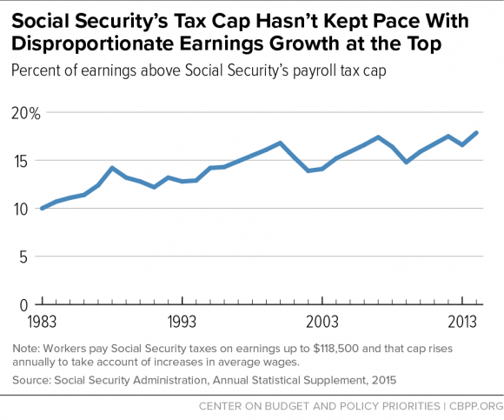
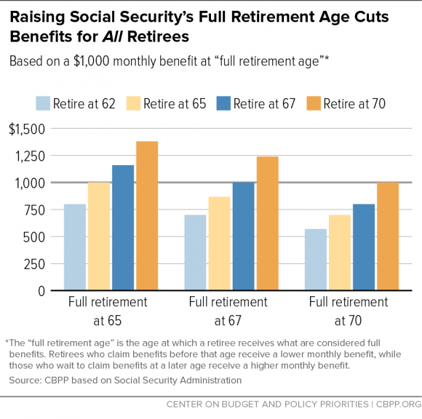
The Solution? A Two-Part Proposal
Raise/Eliminate the Tax Cap
Affects high earners the most
While 6% of the population makes more than this threshold each year, 20% of workers will earn more than the cap for at least 1 year over their lifetime
Raise the Federal Retirement Age
Affects early retirees the most
The majority of those who retire early are low-income workers
Source: ssa.gov
CBPP.org
DC-4042

Slide 6
Is This Solution Possible?
Raise/Eliminate the Tax Cap
The tax cap is raised nearly every year, but it has not kept pace with earnings growth
Reinstate the Reagan standard that 90% of wages are covered by SS tax (today only ~83% are)
Could be feasible
Raise the Federal Retirement Age
A national poll in 2016 found that 8 out of 10 people voted to raise the FRA to 68 after hearing the two sides of this argument presented
Largest effect on low-income workers
Low-income workers also have a much lower voter turnout
Could be feasible
An equitable way to fund the solvency problem — raise taxes on the wealthiest and raise the retirement age for all
Source: SSA.gov, vop.org
DC-4042

Slide 7
Important Disclosures
Investing involves risk including the risk of loss of principal.
The whole or any part of this work may not be reproduced, copied or transmitted or any of its contents disclosed to third parties without SSGA’s express written consent.
The views expressed in this material are the views of Joanne Frangias, Keelin O Laughlin, Catherine Reilly and Melissa Kahn through the period ended June 30, 2017 and are subject to change based on market and other conditions. This document contains certain statements that may be deemed forward-looking statements. Please note that any such statements are not guarantees of any future performance and actual results or developments may differ materially from those projected.
All information has been obtained from sources believed to be reliable, but its accuracy is not guaranteed. There is no representation or warranty as to the current accuracy, reliability or completeness of, nor liability for, decisions based on such information and it should not be relied on as such.
United States: State Street Global Advisors, One Lincoln Street, Boston, MA 02111-2900.
Web: www.ssga.com
© 2017 State Street Corporation — All Rights Reserved.
Tracking Number: DC-4042
Expiration Date: August 31, 2017
DC-4042

Slide 8
Biography
Melissa Kahn, Esq
Melissa is the Managing Director of Retirement Policy for the Defined Contribution team. Melissa leads the DC team in developing and communicating the team's public policy positions as they relate to the retirement market, and will be responsible for cultivating relationships with key retirement policy decision-makers.
Melissa reports directly to Fredrik Axsater and is based in Washington, DC, and in Boston. She works closely with State Street's Regulatory, Industry, and Government Affairs (RIGA) group, which is responsible for coordination of overall State Street public policy positioning and advocacy.
Melissa is an attorney with extensive experience in developing and implementing policy and strategies on domestic and international employee benefits legislation and regulation, as well as Social Security reform. Importantly, she has worked for many years on Retirement Income policy. Immediately prior to joining SSGA, Melissa was a consultant providing strategic planning, policy analysis and advocacy work on a variety of issues, including retirement, long-term care, Social Security, and global employee benefits to financial institutions and large plan sponsor clients in the US. Previously, Melissa worked at MetLife, where she spent 12 years in the company's Washington D.C. government relations office. Melissa also has worked for the Retirement Strategies Group, the American Council of Life Insurance and the Equitable Life Assurance Society of America.
DC-4042

Slide 9
Thank You.
For additional information or any questions on the information covered in today’s presentation, please contact:
Melissa Kahn
202-394-3784
Melissa_Kahn@ssga.com
ssga.com | spdrs.com | spdru.com
DC-4042
9

